Slide 1


New Perspectives for Rural Areas: Economic Impacts of International Migration and Workplace Integration in Rural Carinthia (Austria)
FS 3.221
Impacts of in- and out-migration in rural and mountainous areas of Europe and the Global South
Marika Gruber, Carinthia University of Applied Sciences

Slide 2
Case study region of Carinthia
Border region (Slovenian minority, Alpe-Adria region, intersection of three cultures)
Fourth largest federal state in Austria, but with the lowest population density
570,095 inhabitants (by 1.1.2025, Statistik Austria, Statistik des Bevölkerungsstandes, STATCube query)
93.9% of Carinthian municipalities = rural areas (European Commission and Statistics Austria 2021)
According to population projections, a slight decline in population (-1.4%) is expected by 2080 (Statistik Austria 2024, Pressemitteilung)
Rural areas in Carinthia are already experiencing high rates of migration and declining economic performance (Aigner-Walder et al. 2021; Stainer-Hämmerle/Zametter 2021)
Severe shortage of (skilled) labour, which has been exacerbated by the coronavirus cisis

Slide 3
Migrants in Carinthia
Decline in the working population by 2040: -15.7% (Carinthia); -4.7% (AT) (Aigner-Walder et al. 2021)
13.6% are foreigners (77,758 people) (by 1.1.2025, Statistik Austria, Statistik des Bevölkerungsstandes, STATCube query)
16.9% of population show a migrant background (91,900 people) (by 1.1.2023, Statistik Austria 2024, Statistisches Jahrbuch Migration & Integration)
85% are Austrians, 8.2% are EU/EFTA citizens, 6.8 are TCNs (Österreichischer Integrationsfonds 2024)
10-most important foreign nationalities: Germany (13,938), Bosnia & Herzegovina (8,118), Croatia (7,889), Slovenia (6,365), Romania (5,424), Hungary (3,716), Italy (3,2227), Ukraine (2,649), Syria (2,391), Afghanistan (1,856) (Quelle: Statistik Austria (2024): Bevölkerung zu Jahresbeginn seit 2002)

Slide 4
Overview population decline
 |  | Carinthia
Sex | Age groups | In Austria born | In non-EU countries are born
Men | < 14 Years | -1540 | +1360
Women |  | -1481 | +1320
Men | 15 - 29 Years | -6228 | +2213
Women |  | -6339 | +1045
Men | 30 - 44 Years | -4121 | +4763
Women |  | -3919 | +3490
Men | 45 - 59 Years | -8079 | +2816
Women |  | -8853 | +4092
Women | 60 - 74 Years | +8296 | +2225
Men |  | +8290 | +1973
Men | 75 Years and more | +6005 | +774
Women |  | +4864 | +891
Statistik Austria (2025), Bevölkerung zu Jahresbeginn seit 2002; STATCube-Abfrage vom 25.11.2024; eigene Berechnungen.

Slide 5
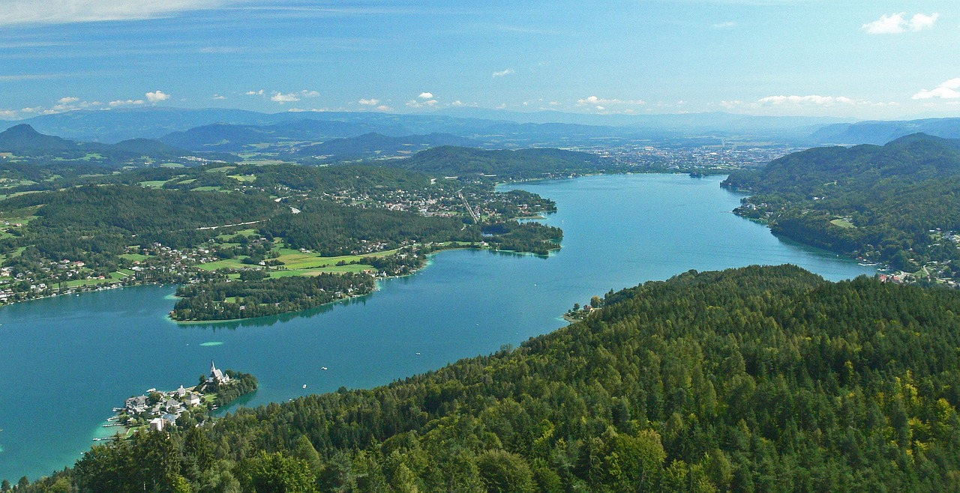
Carinthia

Slide 6
Selected challenges of immigration in Carinthia
Multiple challenges are associated with immigration, e.g.
  lower labour market participation among immigrants (by 2019, Statistics Austria, own calculations)
    Austrian-born men: 76.7% (non-Austrian born men: 69.8%)
    Austrian-born women: 69.4% (non-Austrian born women: 58.6%)
  Higher unemployment rates (by 2019, Statistics Austria, own calculations)
    Austrian-born men: 5.9% (non-Austrian born men: 10.8%)
    Austrian-born women: 6.4% (non-Austrian born women: 13.3%)
  Lower educational level
  Difficulties with school integration due to a lack of language skills of the host country
  International immigration is increasingly seen as a security risk for the places of immigration

Slide 7
Research interest & methodology
Macro-level: contributions and economic impacts that international (third-country) immigration can make to the economic development of a rural region (Carinthia)
Micro-level: challenges and solutions of company onboarding from the perspective of companies and immigrant employees in rural Carinthia
Methodology:
  Project KMU4Carint: 39 interviews with company representatives and international employees from industry, science and tourism
  Horizon 2020 project MATILDE: 21 interviews + 1 focus group with entrepreneurs, managers and employees, both with and without a migrant background

Slide 8
Macro-level results: Economic impacts (I)
Mitigation of negative demographic trends and labour shortages (companies in Carinthia compete for personnel on the global market)
Companies' decisions to maintain and, where appropriate, expand their locations in Carinthia can be seen as an advantage for the local communities
Additional taxes and levies help to maintain services of general interest
Municipal services and administrative processes can be improved through a stronger customer focus
Creating new jobs in the region can counteract the exodus of younger people and make the region attractive to returnees/immigrants (job prospects)
Transcultural development of the (rural) region
Gruber, M./Pöcher, J./Zupan, K. (2022): Ergebnisse aus der Fallstudienregion Kärnten. MATILDE Abschlusskonferenz am 11. November 2022. Villach: FH Kärnten.

Slide 9
Macro-level results: Economic impacts (II)
New services are created, which also benefit the local population
Migrant start-ups, cross-border economic activity
Internationalisation of Carinthia: corporations are strengthening their international orientation and seeking ‘internationally oriented employees’ who can think ‘globally’ (language skills, international professional experience)
Changes in corporate cultures (more tolerant, cooperative and open), accompanying programmes for personnel development
Smaller, peripheral regions can also gain in importance in this way
Diversity, interculturalism and openness can contribute to a region's resilience
Gruber, M./Pöcher, J./Zupan, K. (2022): Ergebnisse aus der Fallstudienregion Kärnten. MATILDE Abschlusskonferenz am 11. November 2022. Villach: FH Kärnten.

Slide 10
Micro-level results: Company onboarding challenges (Migrant view)
Challenges for international employees:
Lack of knowledge about the region
Adapting to new circumstances and a foreign language
Finding accommodation and dealing with the administrative processes involved in relocation
Finding accommodation often proves to be one of the biggest challenges
Support in the form of language courses and intercultural training Team dynamics as a factor influencing social integration
Access to support resources such as the Carinthia International Center
Differences in culture, behaviour and lifestyles
Making new friends
(CIC 2024, Carinthia International)

Slide 11
Recommendations & conclusions
Development of a pre-onboarding package by companies
Implementation of buddy or mentoring systems
Promoting team culture
Operational flexibility: Attractive working models and benefits
Changing Carinthia's self-image: Carinthia often sees itself as a tourist region, but many people also come to settle there permanently
Expanding multilingual services offered by public authorities
Offering opportunities for active involvement and social participation in order to help shape the development of the federal state
Organising events that promote exchange between the local population and newcomers
Companies and local employment agencies should jointly develop programmes to support the partners of international employees in their job search
Provision of clear information about the Austrian school system and advice on childcare
(CIC 2024, Carinthia International)

Slide 12
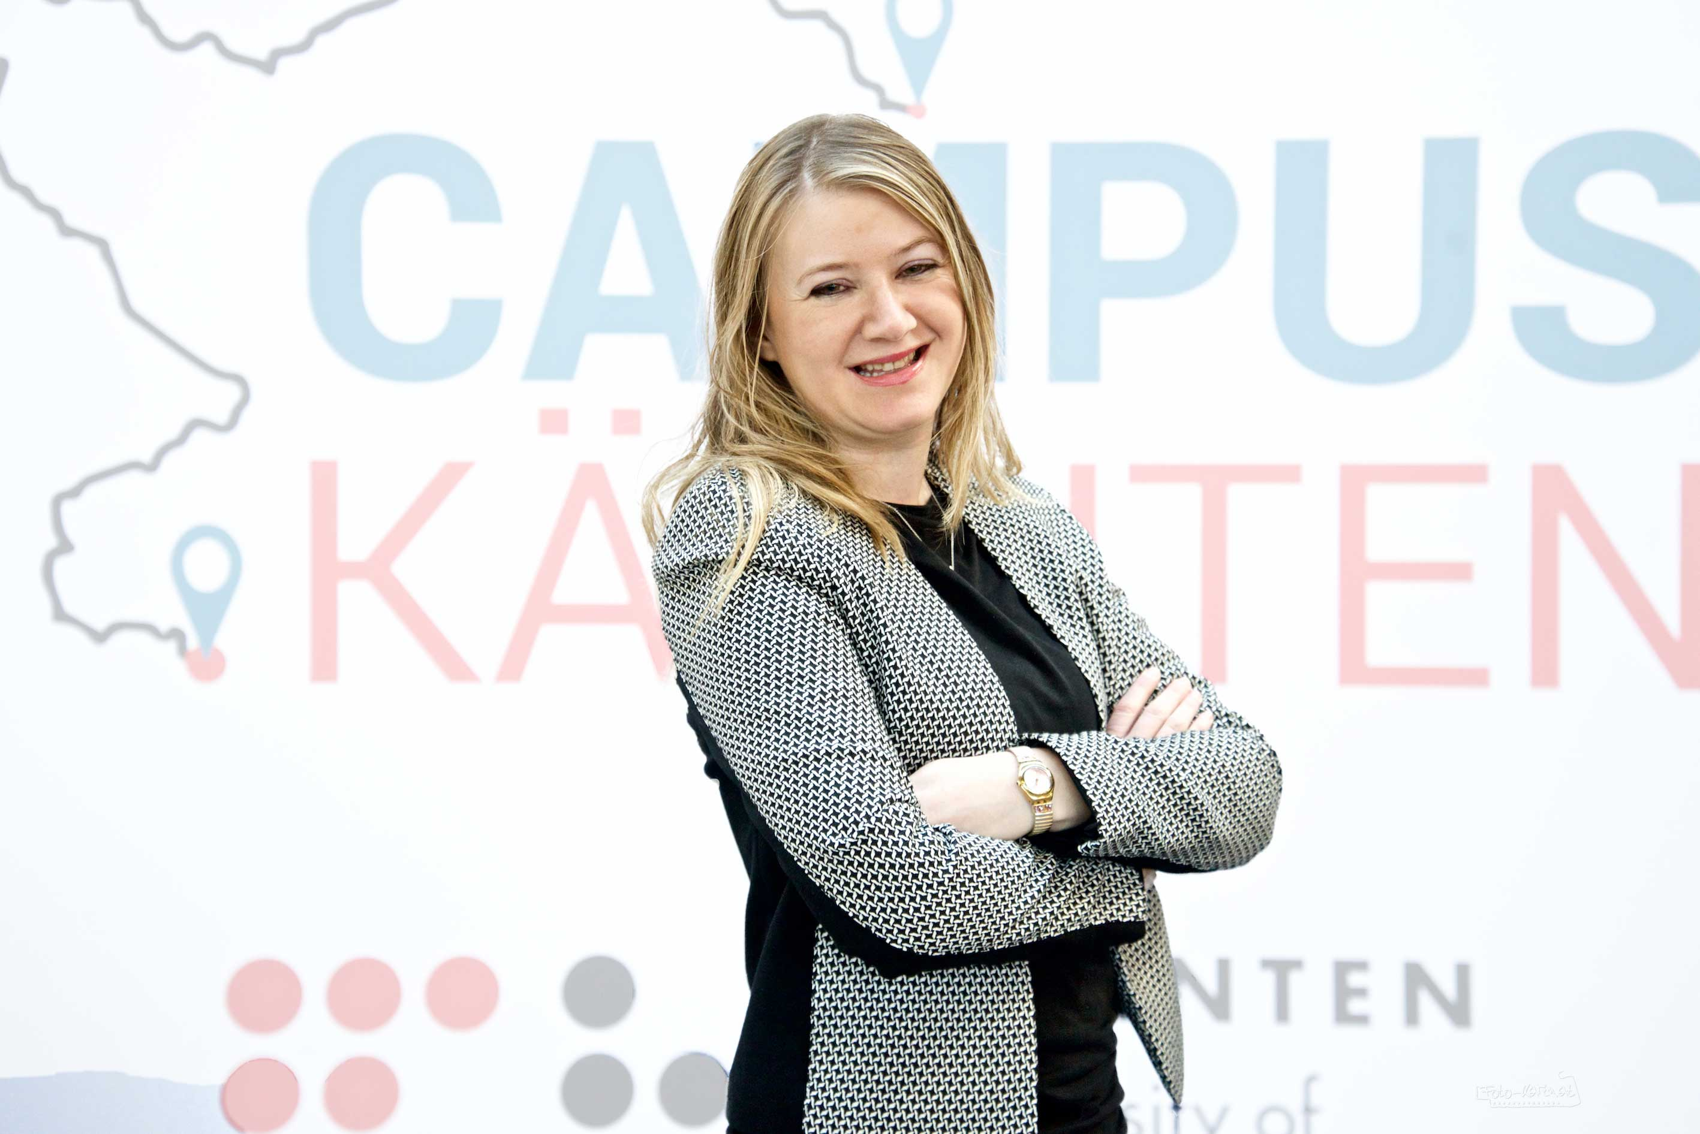
Contact
Dr. Marika Gruber
m.gruber@fh-kaernten.at
+43(0)5/90500-2439

