Slide 1
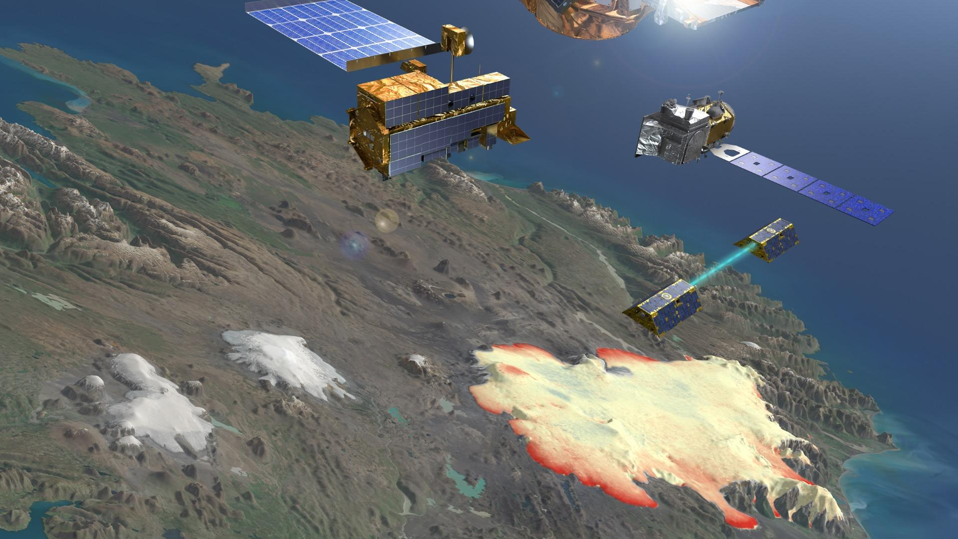


Content
GlaMBIE 1 + results
→ Glacier mass balance; set the context
→ What was done in GlaMBIE 1?
→ Key results
GlaMBIE 2
→ Data submission
  How to engage / participate
→ Pilot study 1
→ Pilot study 2
Outlook
→ Anything from the opinion piece?
→ ESA mission support (CryoSAT-CRISTAL)
Towards a second Glacier Mass Balance Intercomparison Exercise
A Call for Data & Participation
Michael Zemp, Noel Gourmelen, Livia Jakob, Samuel U. Nussbaumer, Ethan Welty, Livia Piermattei, Etienne Berthier, and the GlaMBIE community
www.glambie.org, info@glambie.org

Slide 2
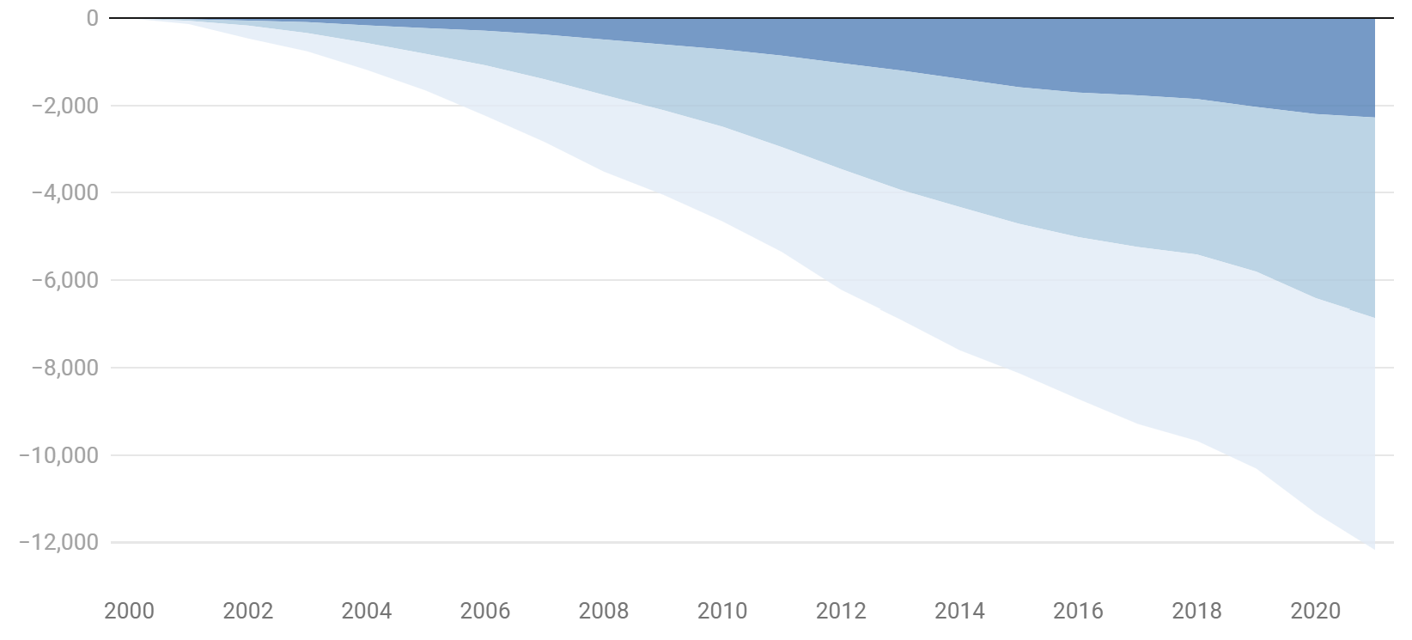
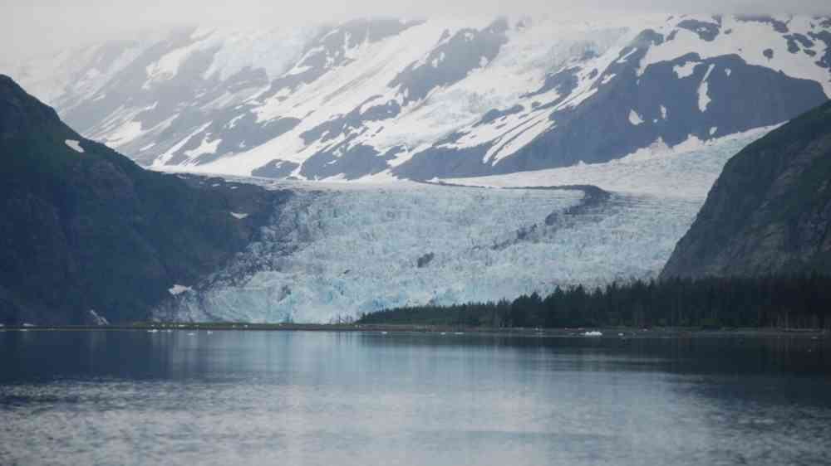
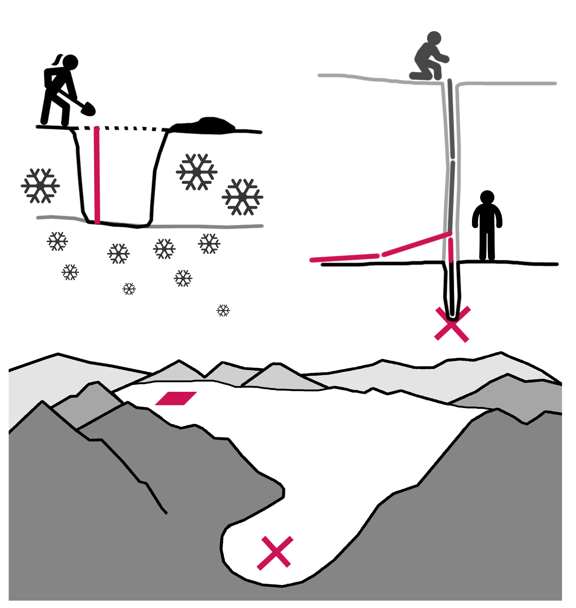
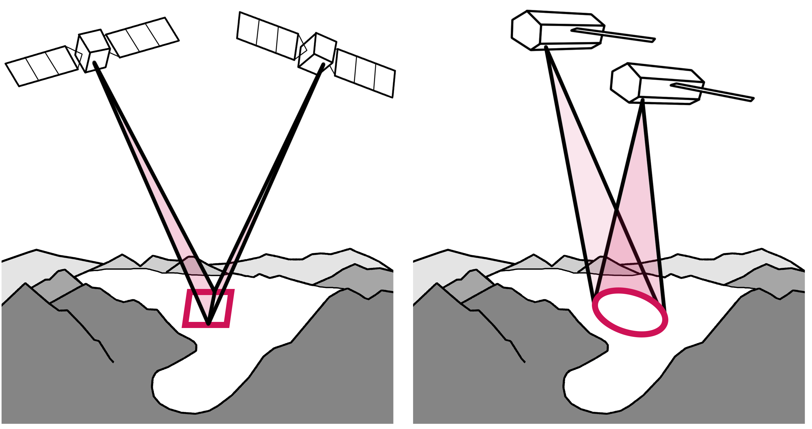
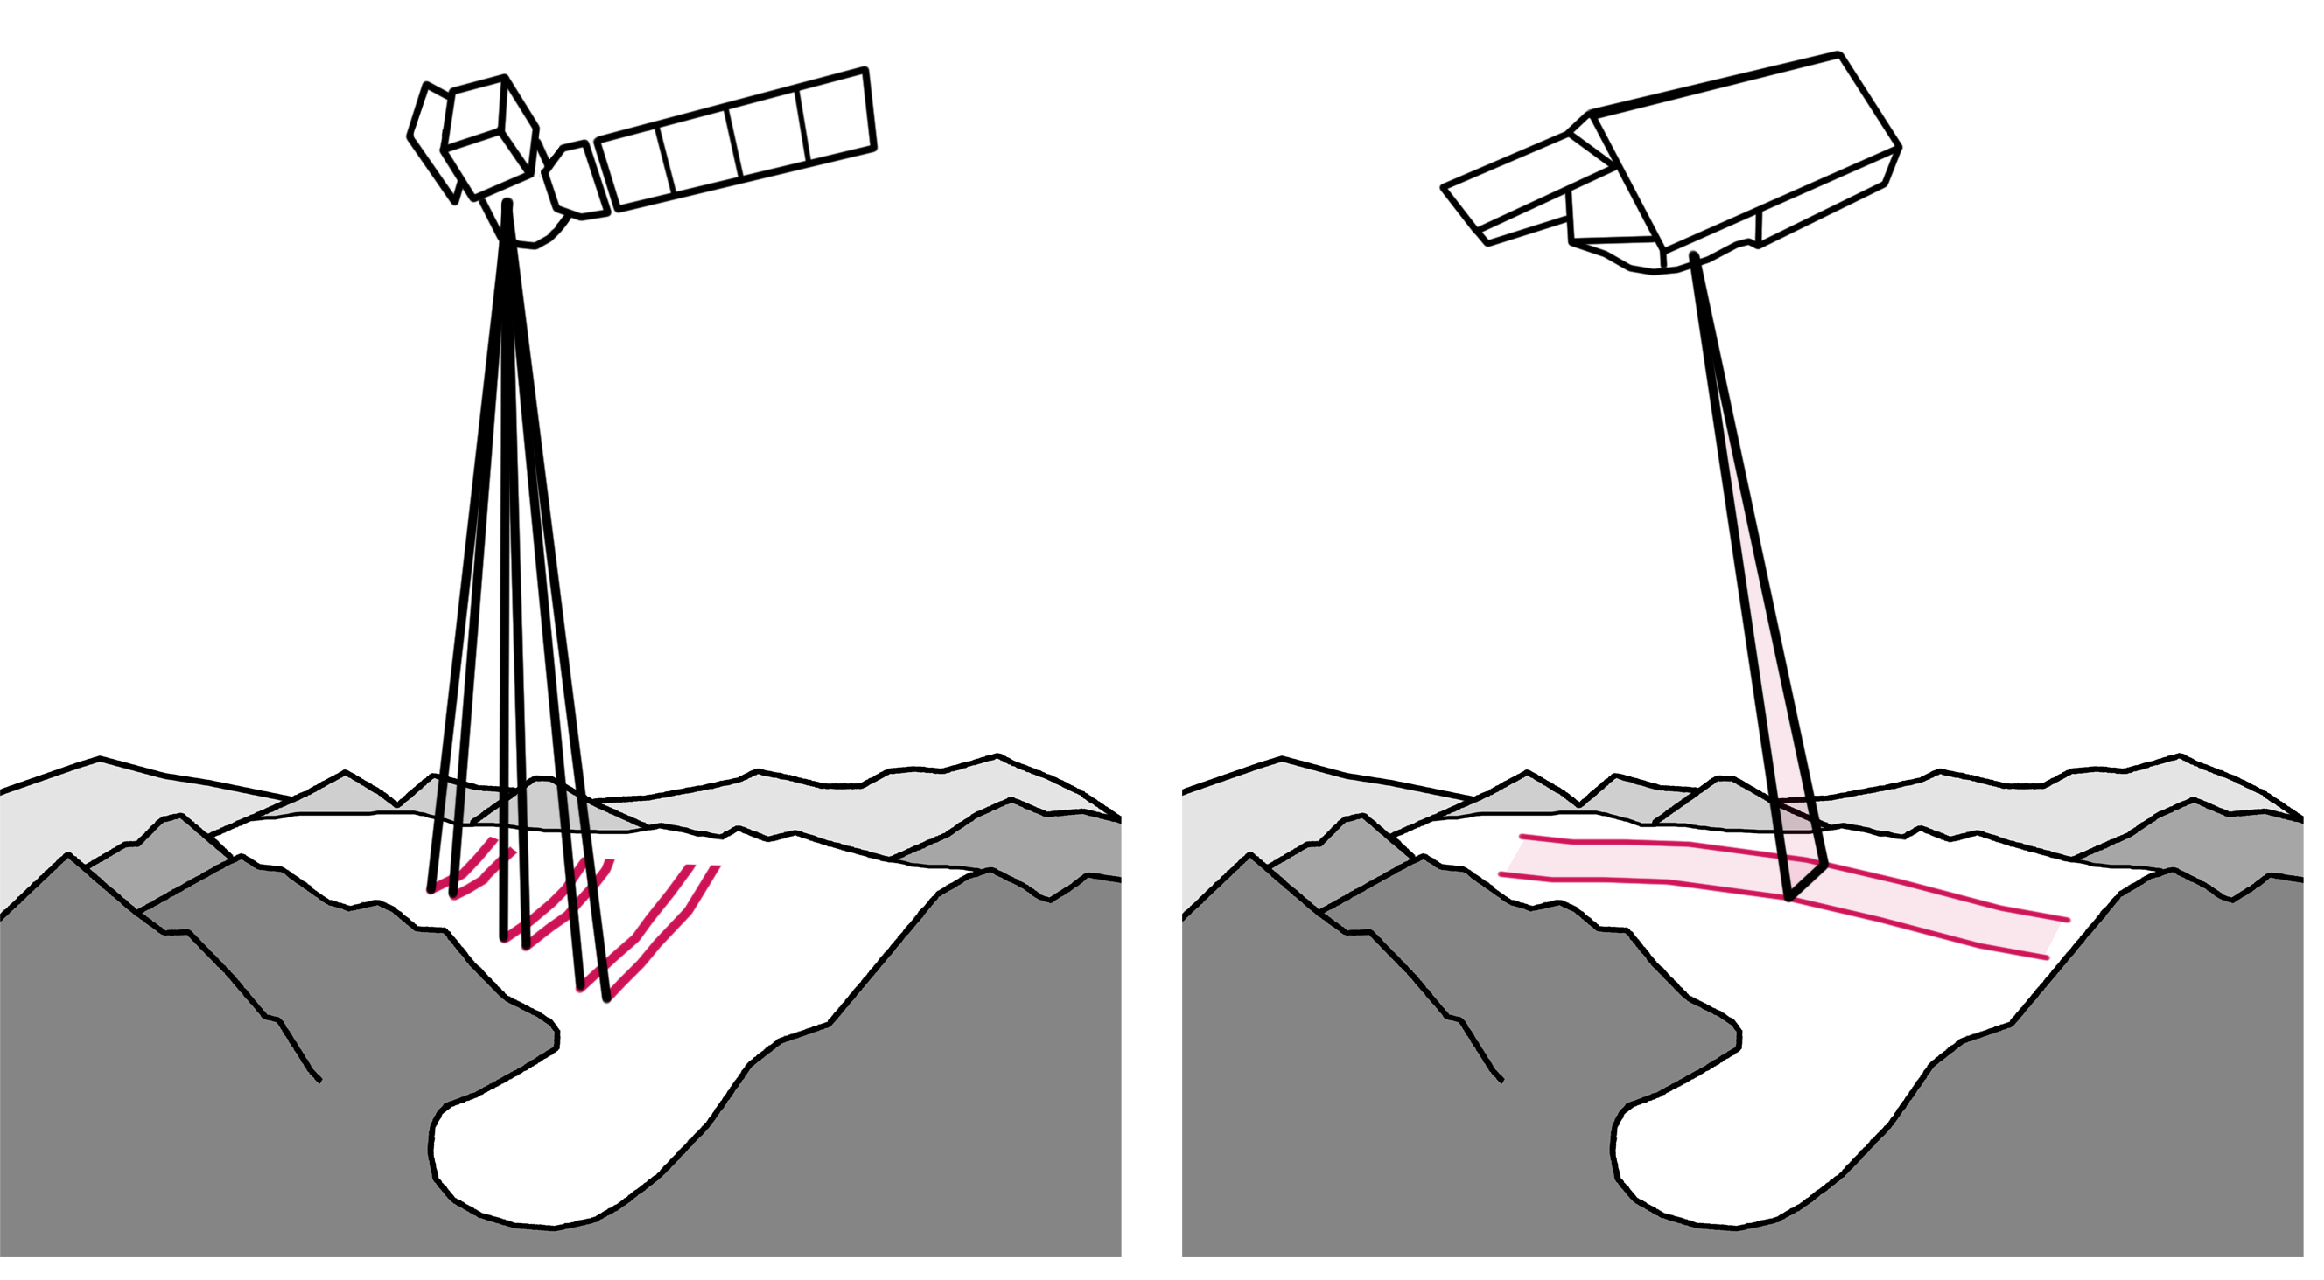
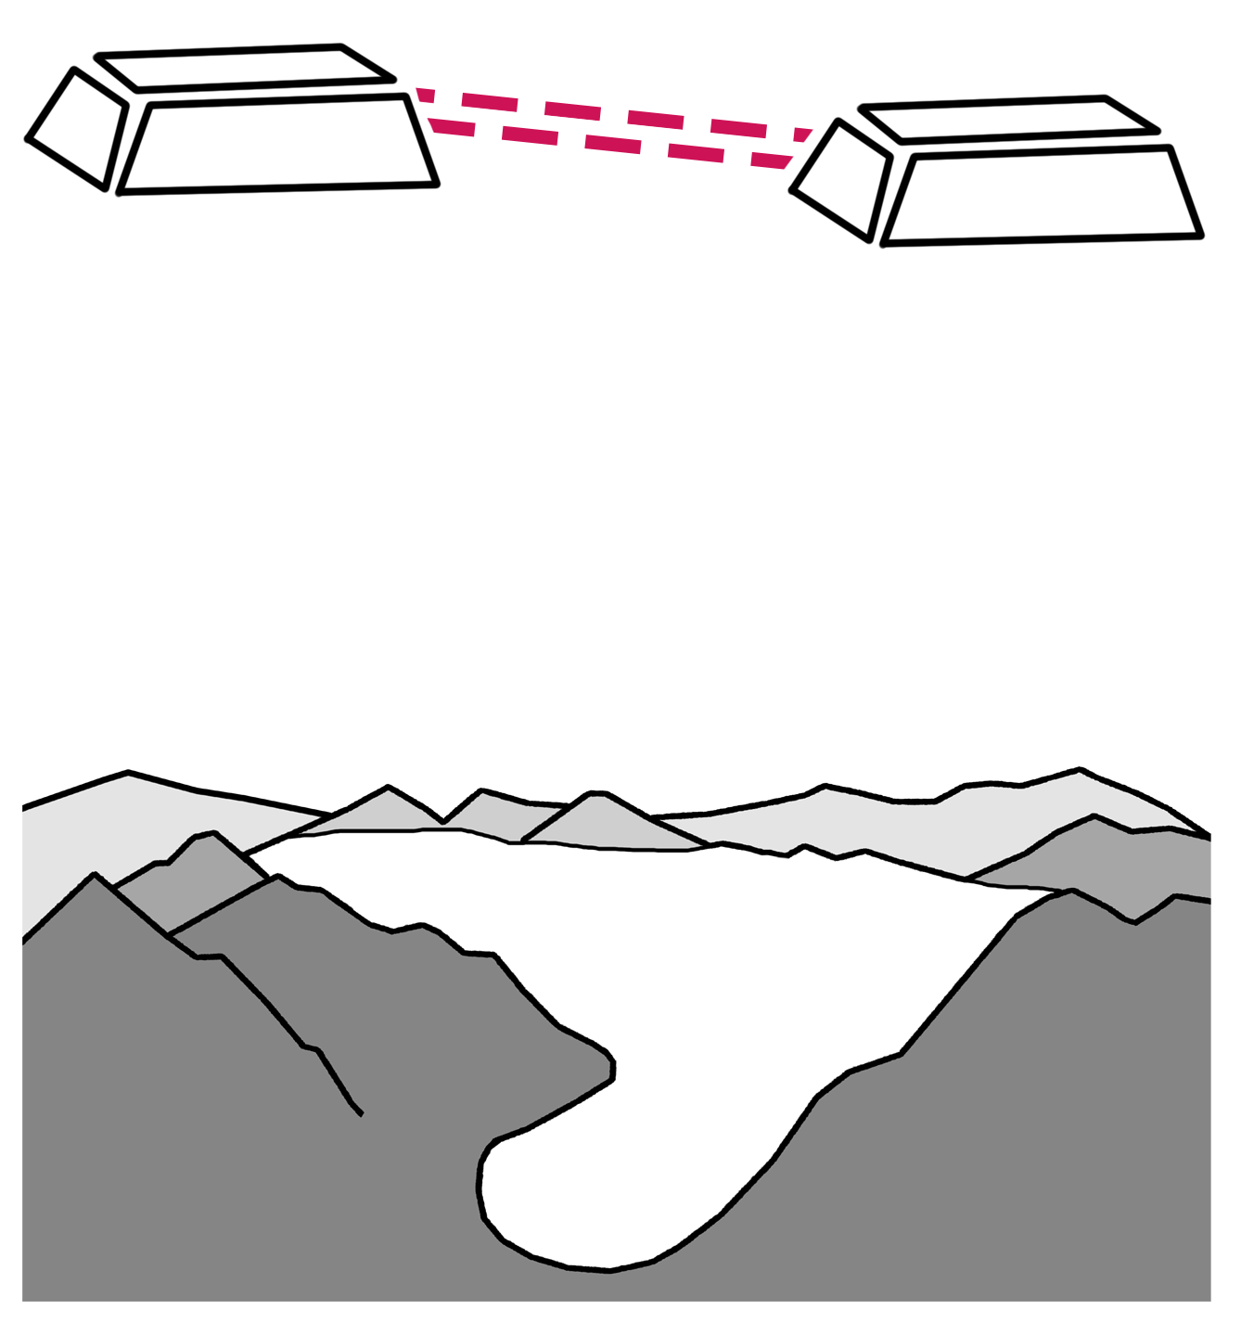
Glacier mass balance
Antarctica
Greenland
Ice loss [Gt]
Sea level rise
Glaciers
Regional freshwater availability
Figure by Chris Mooney based on GlaMBIE & IMBIE data
In situ
DEM differencing
Altimetry
Gravimetry
How to measure it?
stereo images
radar
laser
radar
The GlaMBIE Team (2025), Nature

Slide 3

Observation methods – DEM differencing
DEM differencing
stereo images
radar
The GlaMBIE Team (2025)

Slide 4
Observation methods - altimetry
Altimetry
laser
radar
The GlaMBIE Team (2025)

Slide 5
Observation methods - gravimetry
Gravimetry
The GlaMBIE Team (2025)

Slide 6
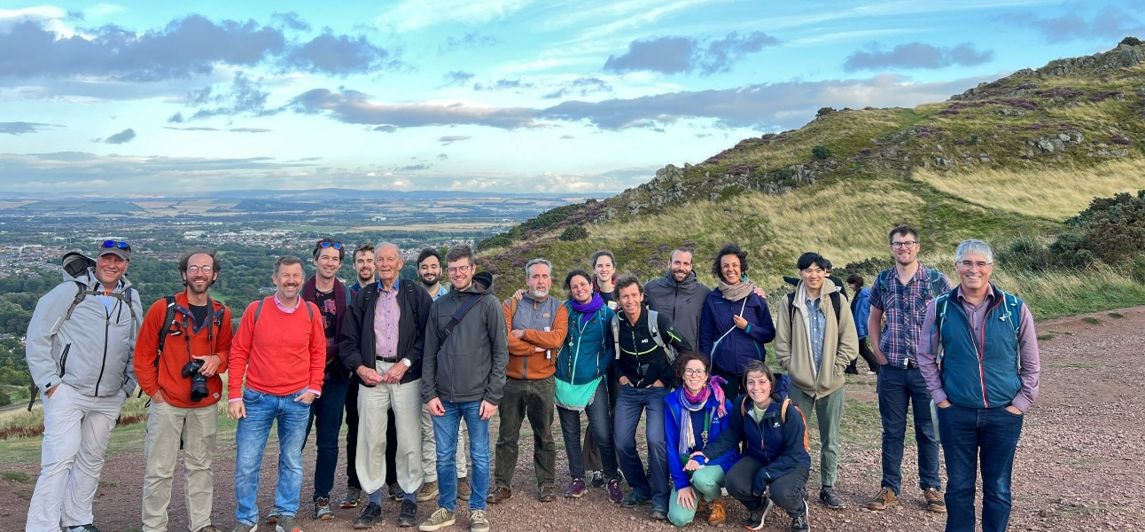

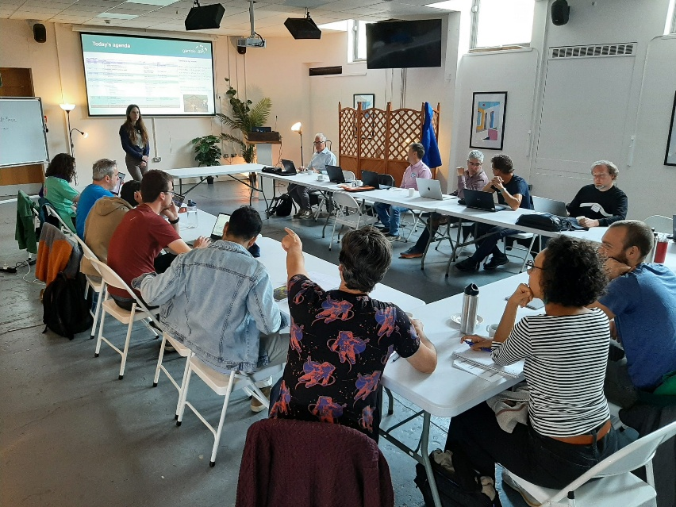
Community effort
GlaMBIE –
Glacier Mass Balance Intercomparison Exercise
Community effort
to generate a
combined estimate
of glacier mass changes
at regional and global levels based on the
main observational sources

Slide 7
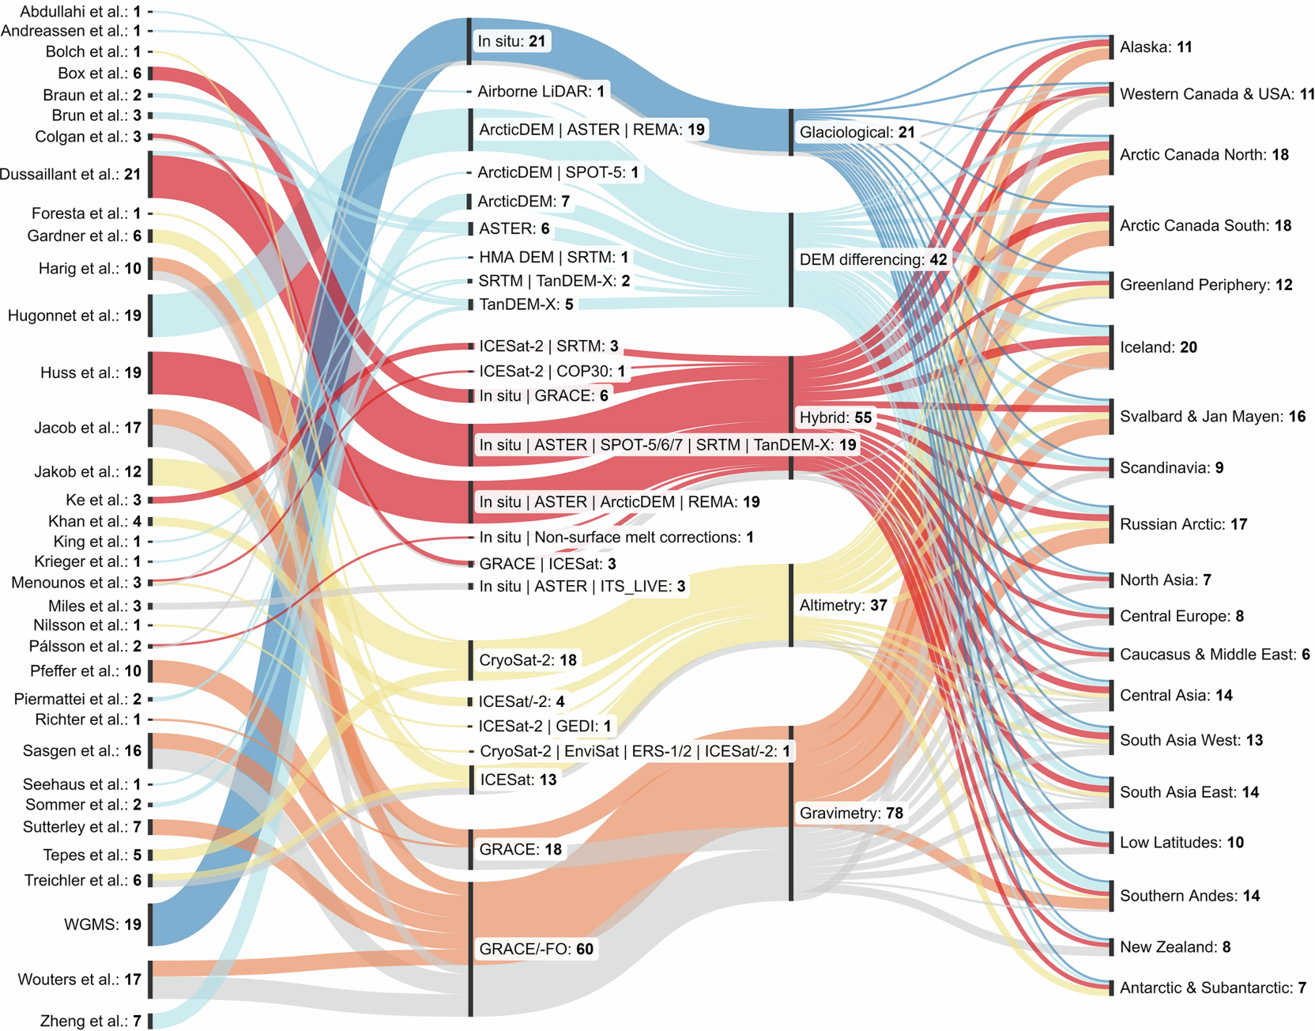
Community input into GlaMBIE
Community effort
Research team
Sensor/product
Method .
Region
35 research groups
21 sensor combinations
4 observational methods
Glaciological
DEM differencing
Altimetry
Gravimetry
& (Hybrid)
19 glacier regions
233 mass change estimates
period 2000 – 2023
The GlaMBIE Team (2025), Nature
The GlaMBIE Team (2025), Nature

Slide 8
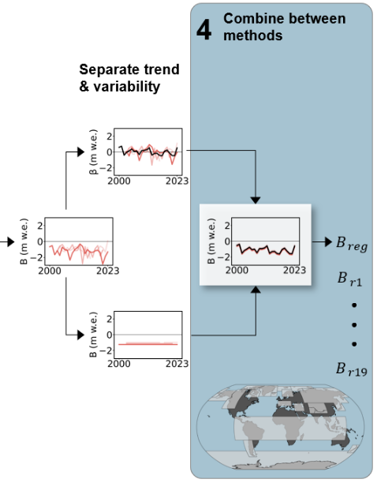
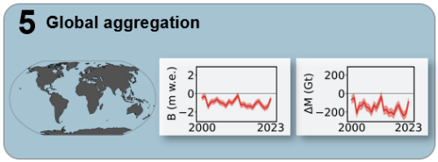
The GlaMBIE approach workflow in a nutshell
Methods
1
WITHIN methods
Compile data at best resolution and unit
Homogenize data
(space, time, units, area)
2
Separate temporal variability and
long-term trend
Combined
Altimetry
Combined
Gravimetry
Combined DEM differencing & Glaciological
3
Combine datasets within methods
4
AMONG methods
Combine among methods into regional estimates
5
Sum up to global estimates
The GlaMBIE Team (2025), Nature

Slide 9
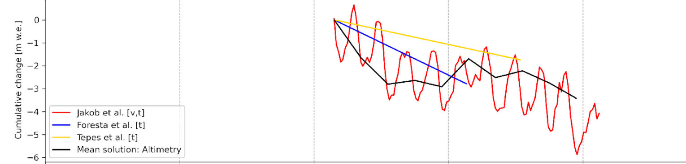
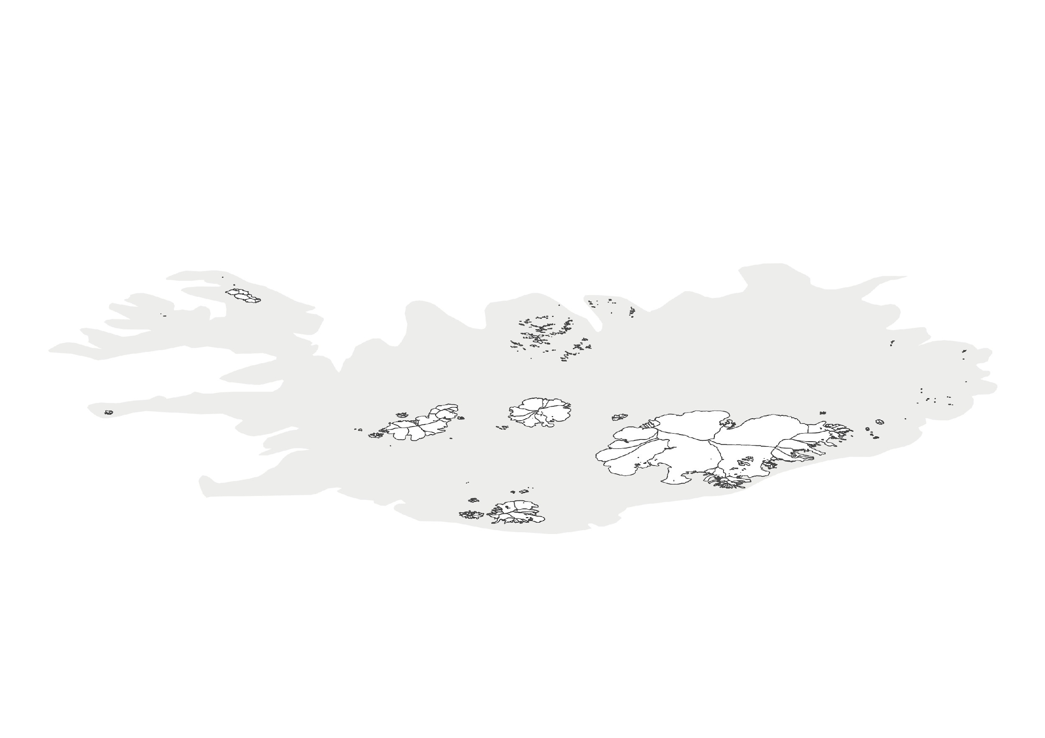
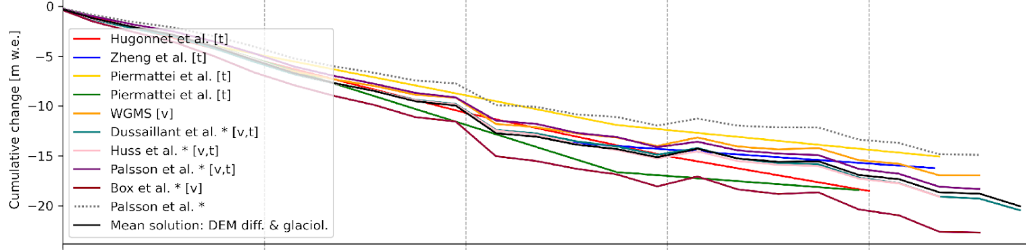
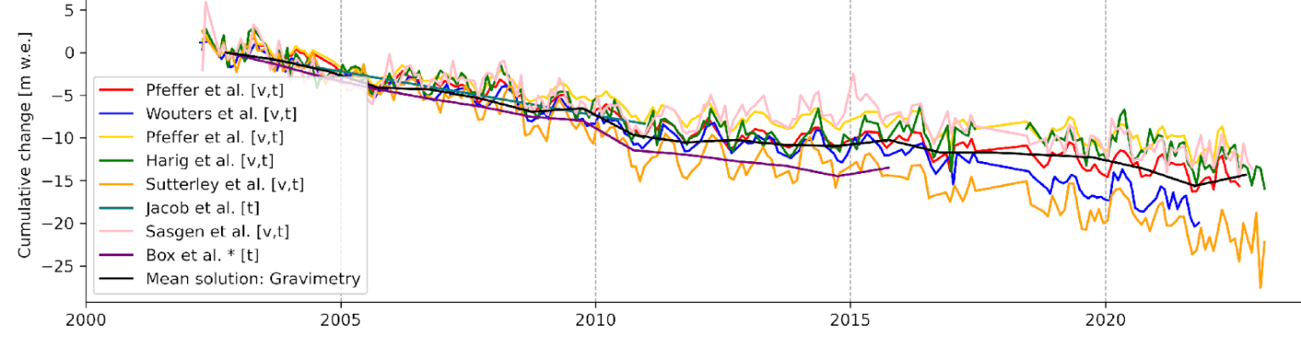
Methods
Data submissions and results | e.g. Iceland
1
Altimetry
Compile data at best resolution and unit
Homogenize data
(space, time, units, area)
2
Separate temporal variability and
long-term trend
DEM diff. & glaciol.
unselected dataset
3
Combine datasets within methods
Gravimetry
The GlaMBIE Team (2025), Nature

Slide 10
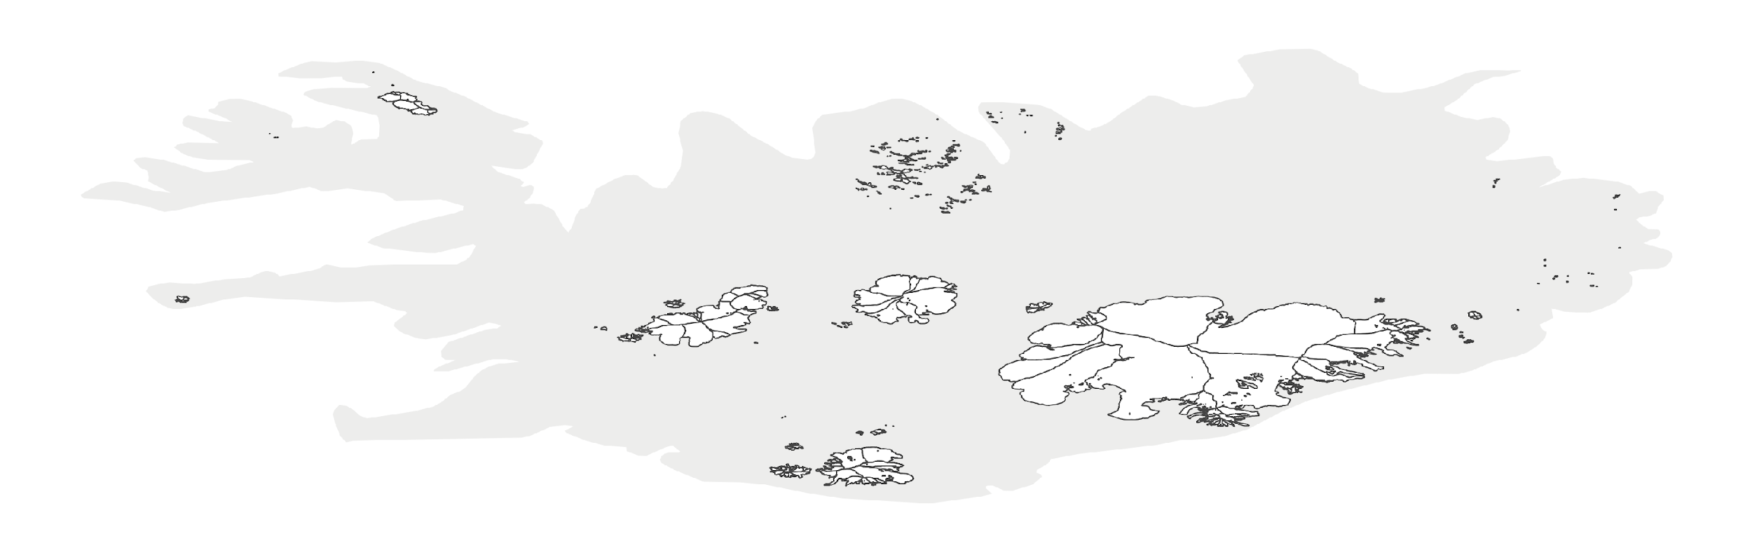
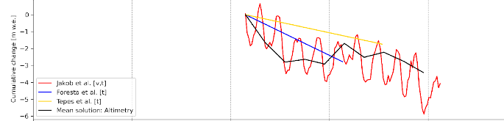

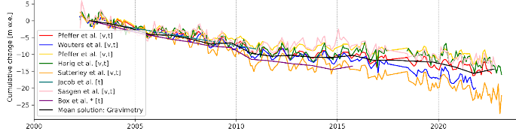
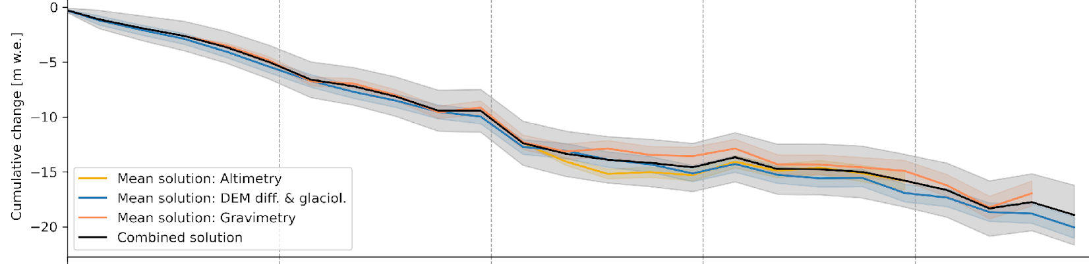
Methods
Data submissions and results | e.g. Iceland
4
Combine among methods into regional estimates
Altimetry
DEM diff. & glaciol.
Gravimetry
Altimetry
DEM diff & glaciological
Gravimetry
Combined estimate
2000
2005
2010
2015
2020

Slide 11
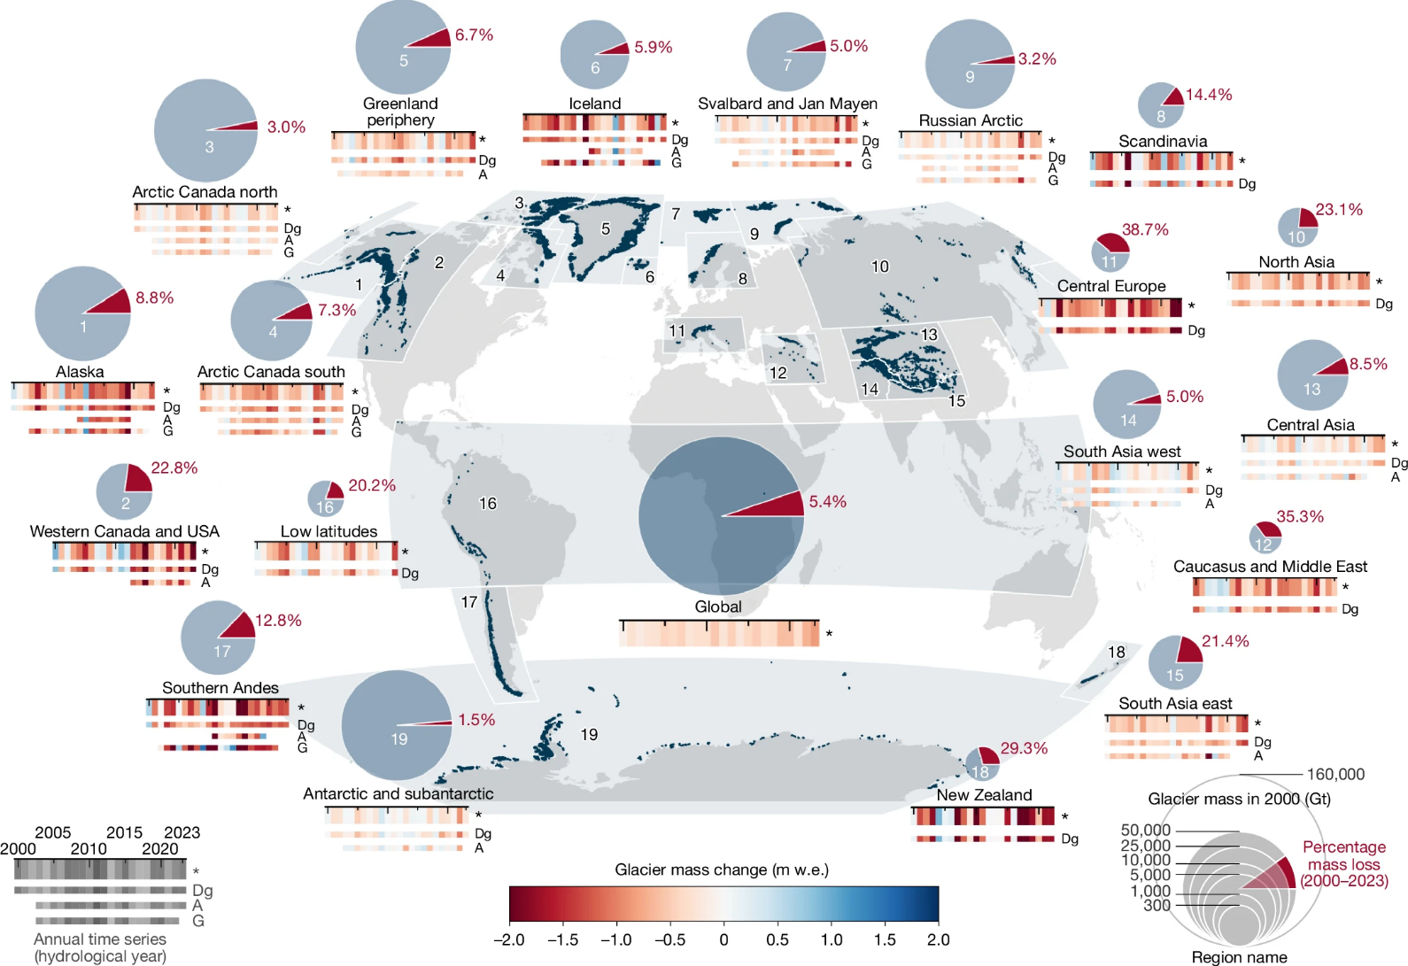
Global mass loss
Global glacier mass changes from 2000 to 2023
5
Sum up to global estimates
Percentage ice loss since 2000
Global loss: 5% since 2000
Regional loss: 2% to 40%
Global mass loss rate: 273±16 Gt
The GlaMBIE Team (2025), Nature

Slide 12
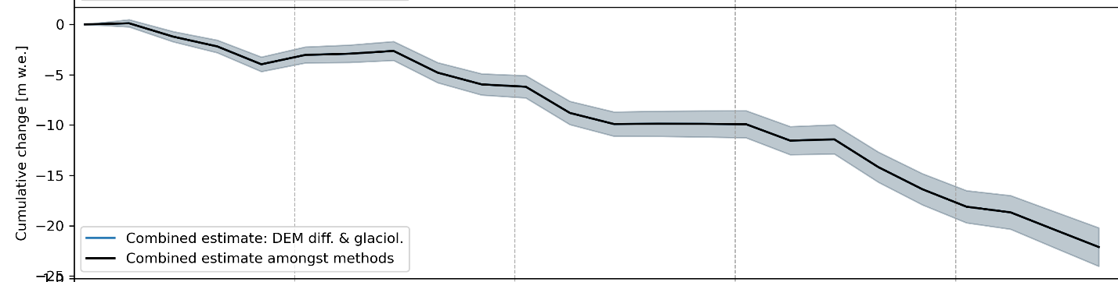
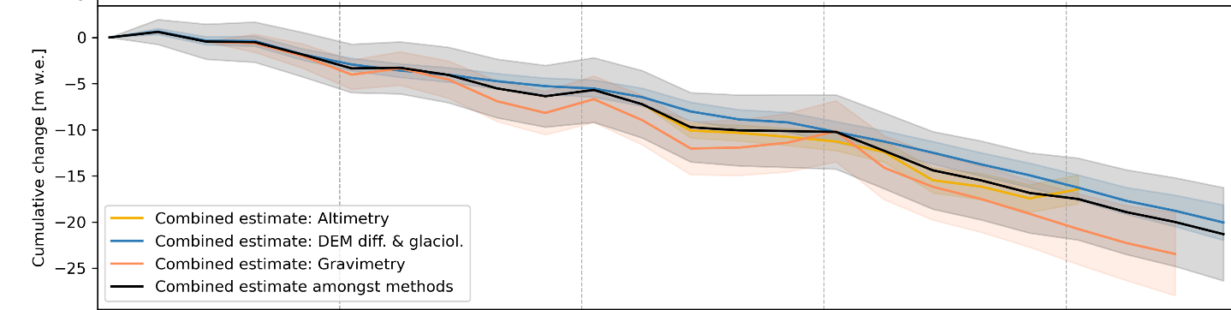
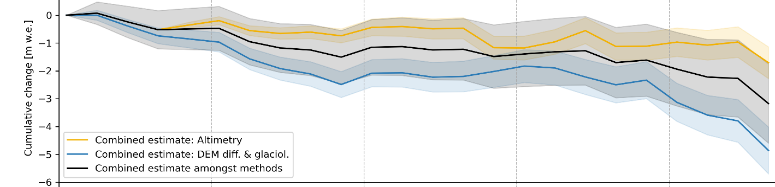
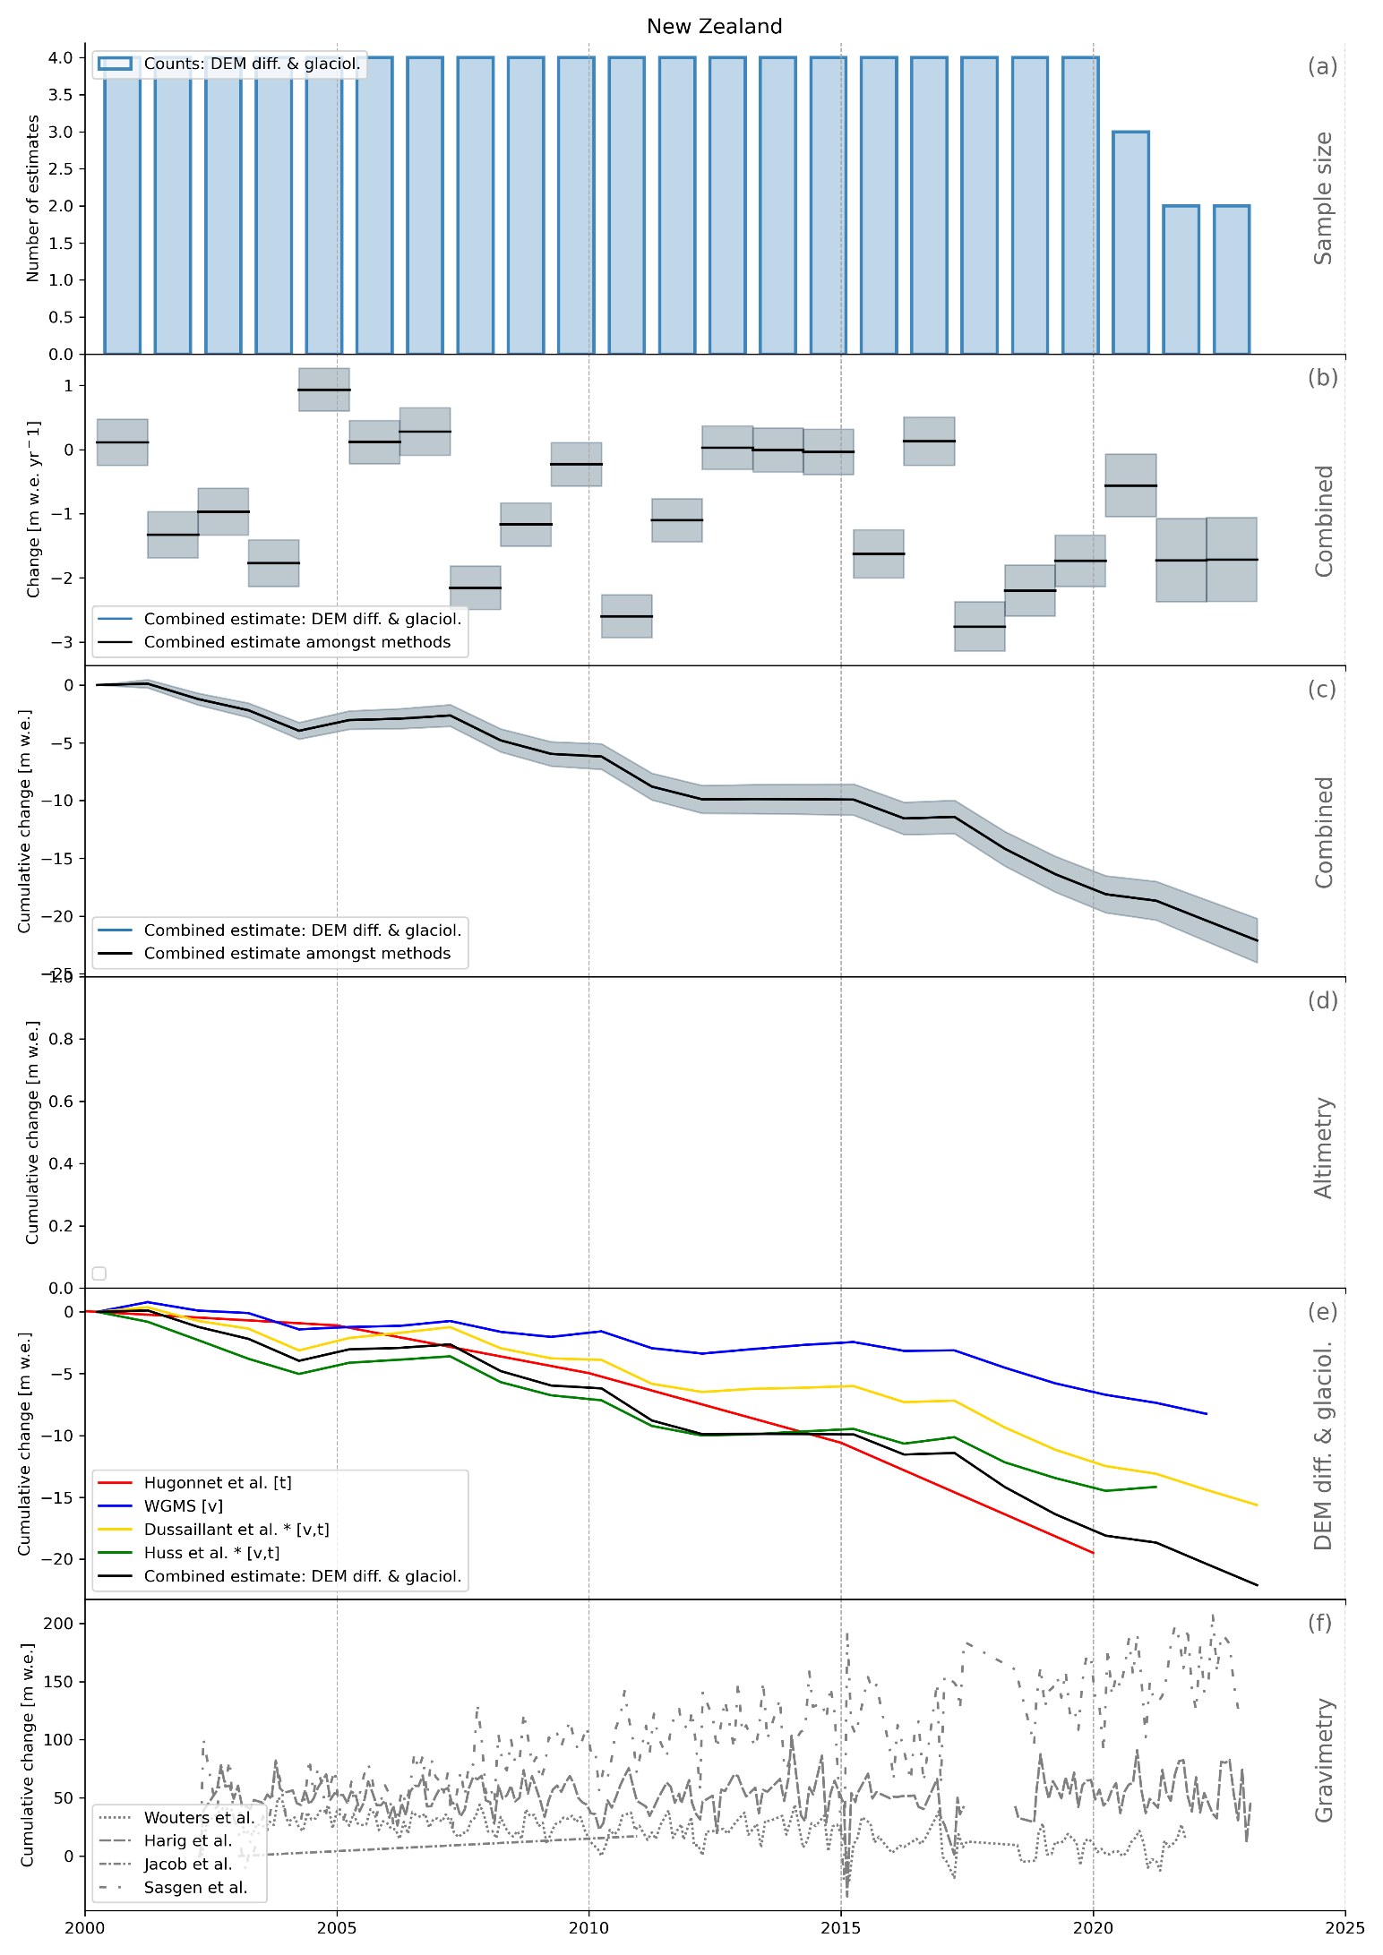
New Zealand
Differences between sources
GlaMBIE: Differences between data sources
Not all methods available for all regions
DEM diff. more negative than Altimetry → GlaMBIE 2.0
Some regions are more challenging (e.g., Antarctic and Subantarctic Islands)
New Zealand
Southern Andes
The GlaMBIE Team (2025), Community estimate of global glacier mass changes from 2000 to 2023. Nature. https://doi.org/10.1038/s41586-024-08545-z
Zemp et al. (2025), Glacier monitoring from space is crucial, and at risk. Eos. https://doi.org/10.1029/2025EO250290
Antarctic & Subantarctic islands

Slide 13
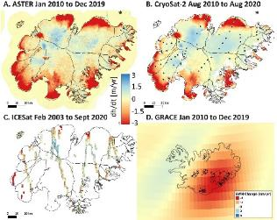
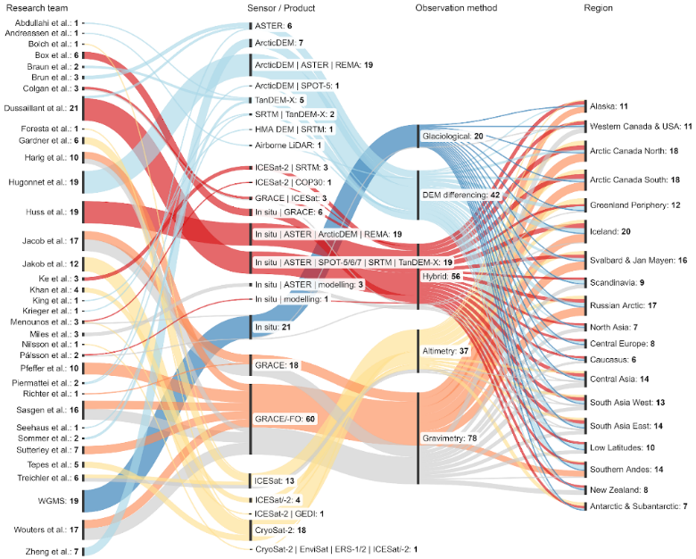
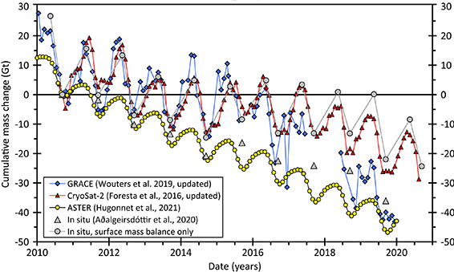
What is GlaMBIE-2 ?
Pilot 1: Explore systematic differences between methods
Core activity: Updated Mass Balance Assessment (Regional + Global)
Pilot 2: Increase temporal and spatial resolution

Slide 14

What is GlaMBIE-2 ?
Pilot 1: Explore systematic differences between methods
Core activity: Updated Mass Balance Assessment (Regional + Global)
Contribute?
Submit Data: Mass & elevation change data at regional level (full GTN-G region)
Active contributions to topics such as uncertainty estimation, glacier area change, density conversion and data combination workflow
Pilot 2: Increase temporal and spatial resolution

Slide 15
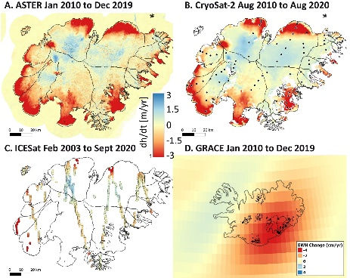
What is GlaMBIE-2 ?
Pilot 1: Explore systematic differences between methods
Core activity: Updated Mass Balance Assessment (Regional + Global)
Contribute?
Test data: Altimetry / DEM Differencing elevation change grids
+ Active contribution
Contribute?
Submit Data: Mass & elevation change data at regional level (full GTN-G region)
Active contributions to topics such as uncertainty estimation, glacier area change, density conversion and data combination workflow
Pilot 2: Increase temporal and spatial resolution

Slide 16
What is GlaMBIE-2 ?
Pilot 1: Explore systematic differences between methods
Core activity: Updated Mass Balance Assessment (Regional + Global)
Contribute?
Test data: Altimetry / DEM Differencing elevation change grids
+ Active contribution
Contribute?
Submit Data: Mass & elevation change data at regional level (full GTN-G region)
Active contributions to topics such as uncertainty estimation, glacier area change, density conversion and data combination workflow
Pilot 2: Increase temporal and spatial resolution
Contribute?
Test data: Glacier or basin-wide estimates OR monthly estimates
+ Active contribution

Slide 17
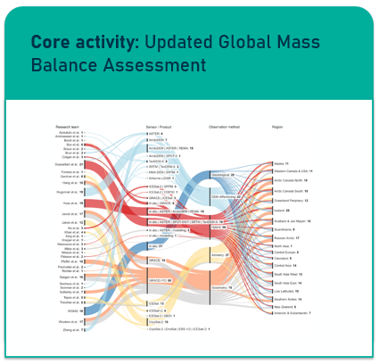
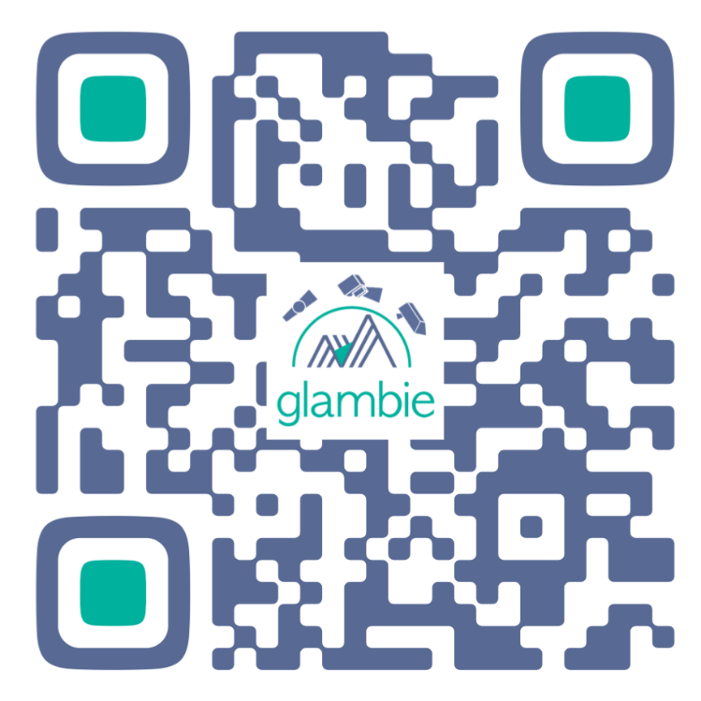
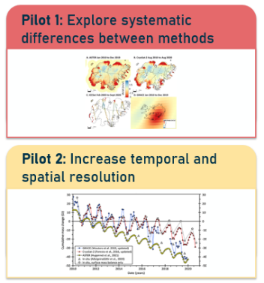
How to participate in GlaMBIE-2 ?
Register interest
Data submission through GlaMBIE portal
Call for data and active participation
Join online info event:
24 Sep 2025, 09:00 CEST
24 Sep 2025, 18:00 CEST
Call for data and active participation
www.glambie.org, info@glambie.org

