Slide 1
From hype to field reality: Soil Amendments and Seedling Survival in Mountain Forests
FS 3.191
Management of post-disturbance mountain forest recovery
Marie Lambropoulos¹, Sebastian Raubitzek², Hans Sandén¹, Boris Rewald³
¹ BOKU University Vienna, ² SBA Research, ³ Mendel-University Brno
Notes:
Hello everyone. My name is Marie Lambropoulos, and I am a Conservationist and Plant Ecologist at BOKU University Vienna, Austria. Today I want to take you from hype to field reality — looking at soil amendments and seedling survival in mountain forest restoration.

Slide 2
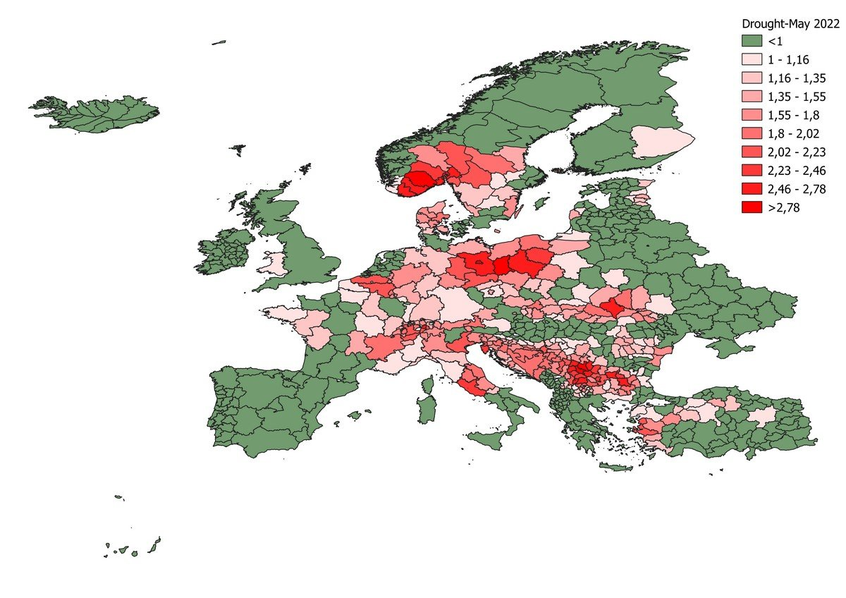
E3CI index on DROUGHT
https://www.ifabfoundation.org/2022/06/10/2022-european-drought/
13.06.2022
Notes:
To give you an impression on why we have to talk about this – you all know we hear a lot about climate change mitigation and the need for planting more trees. In recent years the effects of droughts are causing significant damage to wide forest areas. We need to effectively restore, reforest and aforest - particularly in marginal protection forest sites where natural rejuvenation is insufficient. But unfortunately, and as a consequence of drought, we experience high seedling mortality. In our study, we observed mean total mortality rates of 55%, with some sites experiencing mortality rates as high as 90%. These findings underscore the urgent need to adapt our reforestation strategies, to better cope with these conditions.
With high hopes, we investigated the effect of different soil amendments, including hydrogels and fertilizers, and comparing different planting methods in a 2 year study. Let me give you a quick insight on how that went.

Slide 3
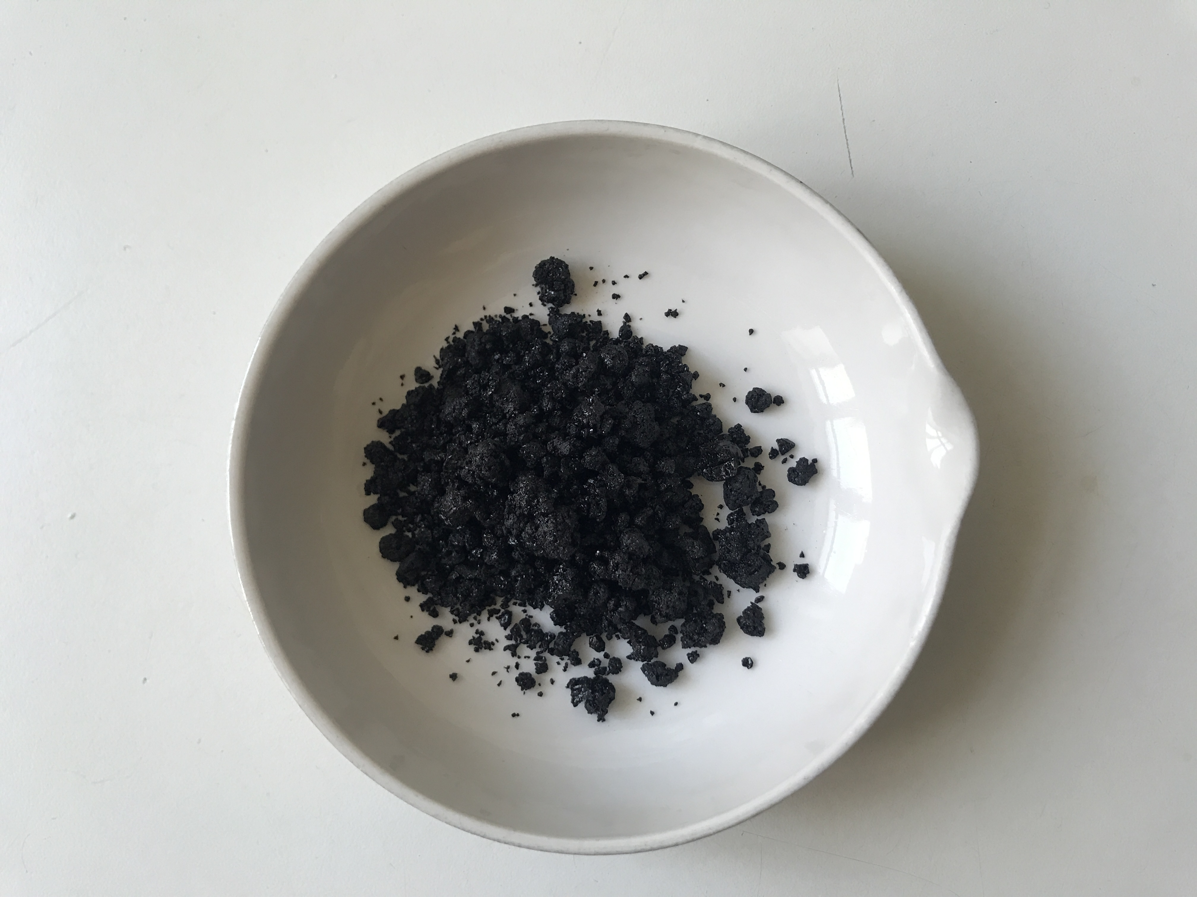

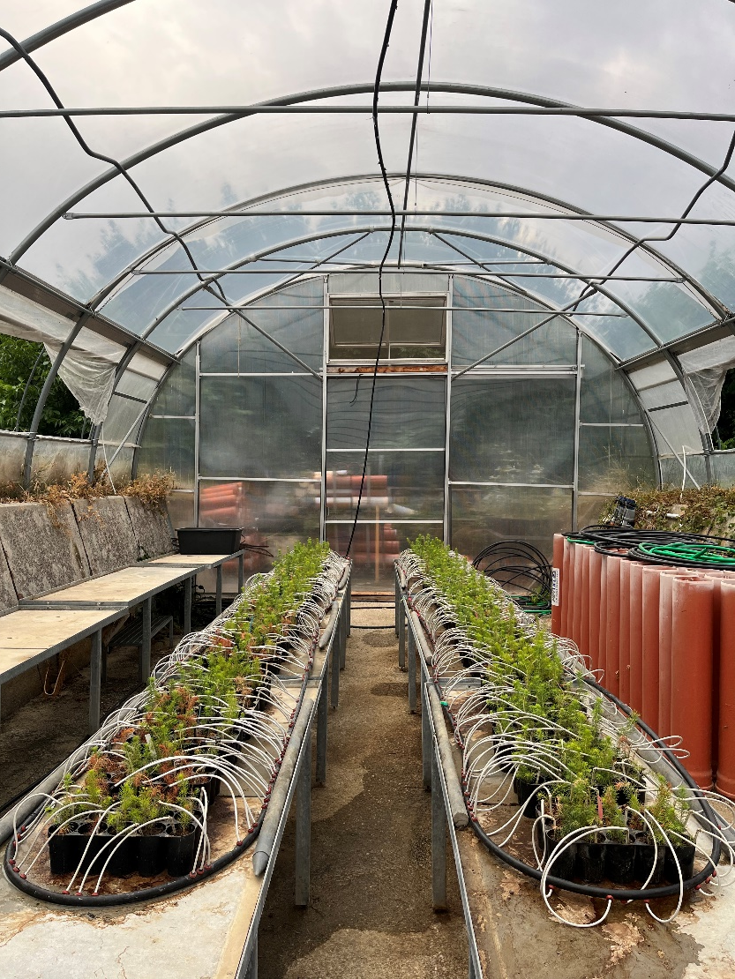
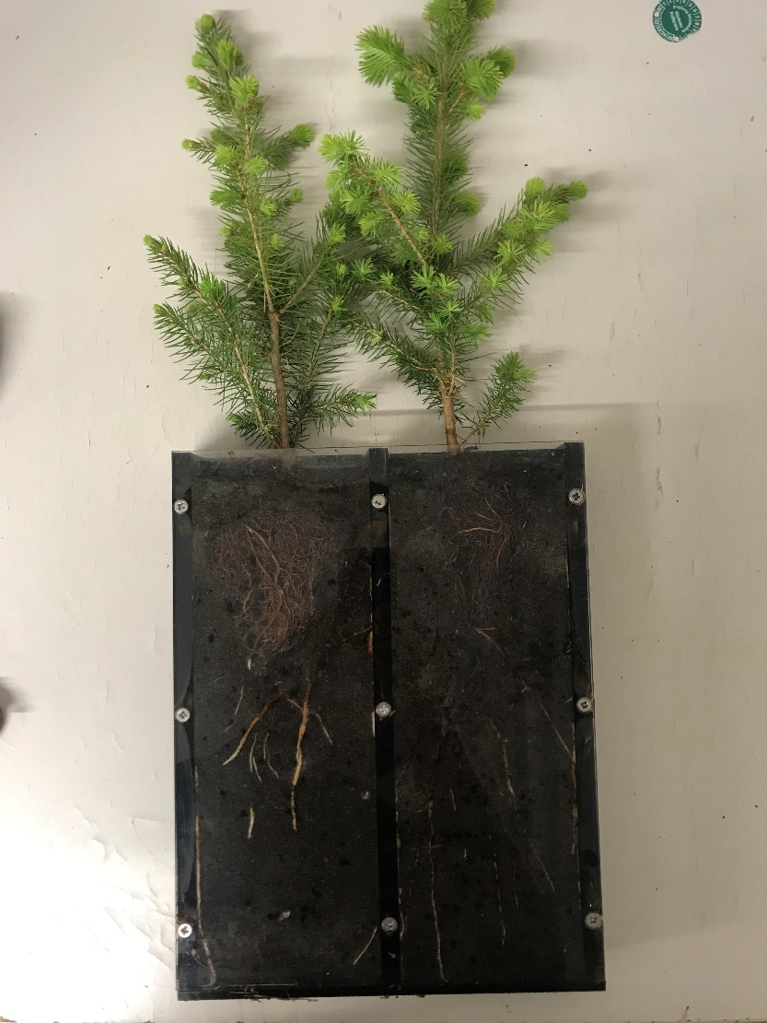


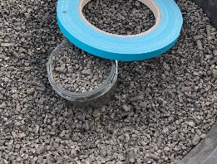

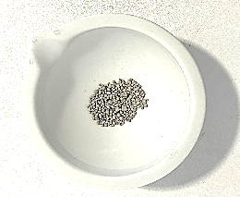

Soil amendments
Hydrogel lignin-based
Hydrogel cellulose-based
Fertilizer NPK,
longterm fertilizer
Fertilizer aminoacidic,
Arginine-based
Notes:
So why did we test amendments? In theory, and whats advertised about them, looks great. Hydrogels swell and store water, fertilizers promise quick nutrient access. In controlled greenhouse and pot experiments, they often boost seedling growth and reduce drought stress. The expectation was that these effects would translate into the field , knowing that those real and uncontrollable mountain forest conditions are very different.

Slide 4
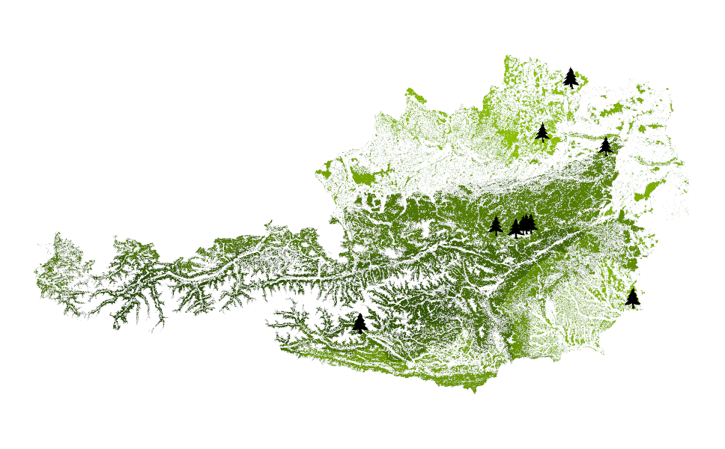
Methods
28.000
Total nr of seedlings
25
Plots planted year 2022 & 2023
4
Amendments
4
Planting methods
Data: Waldkarte BFW Österreich
Notes:
Austria covers a range of climate zones from continental to temperate and alpine making it a good example for investigating reforestation success in central Europe. On the map you see the distribution of our 25 plots. In total we planted 28.000 seedlings with 8 treatments on field sites using the three most commonly planted tree species Sessile Oak in the lower elevations and, Northern Spruce and European Larch in higher elevations. The different shades of green represent different growth areas.

Slide 5
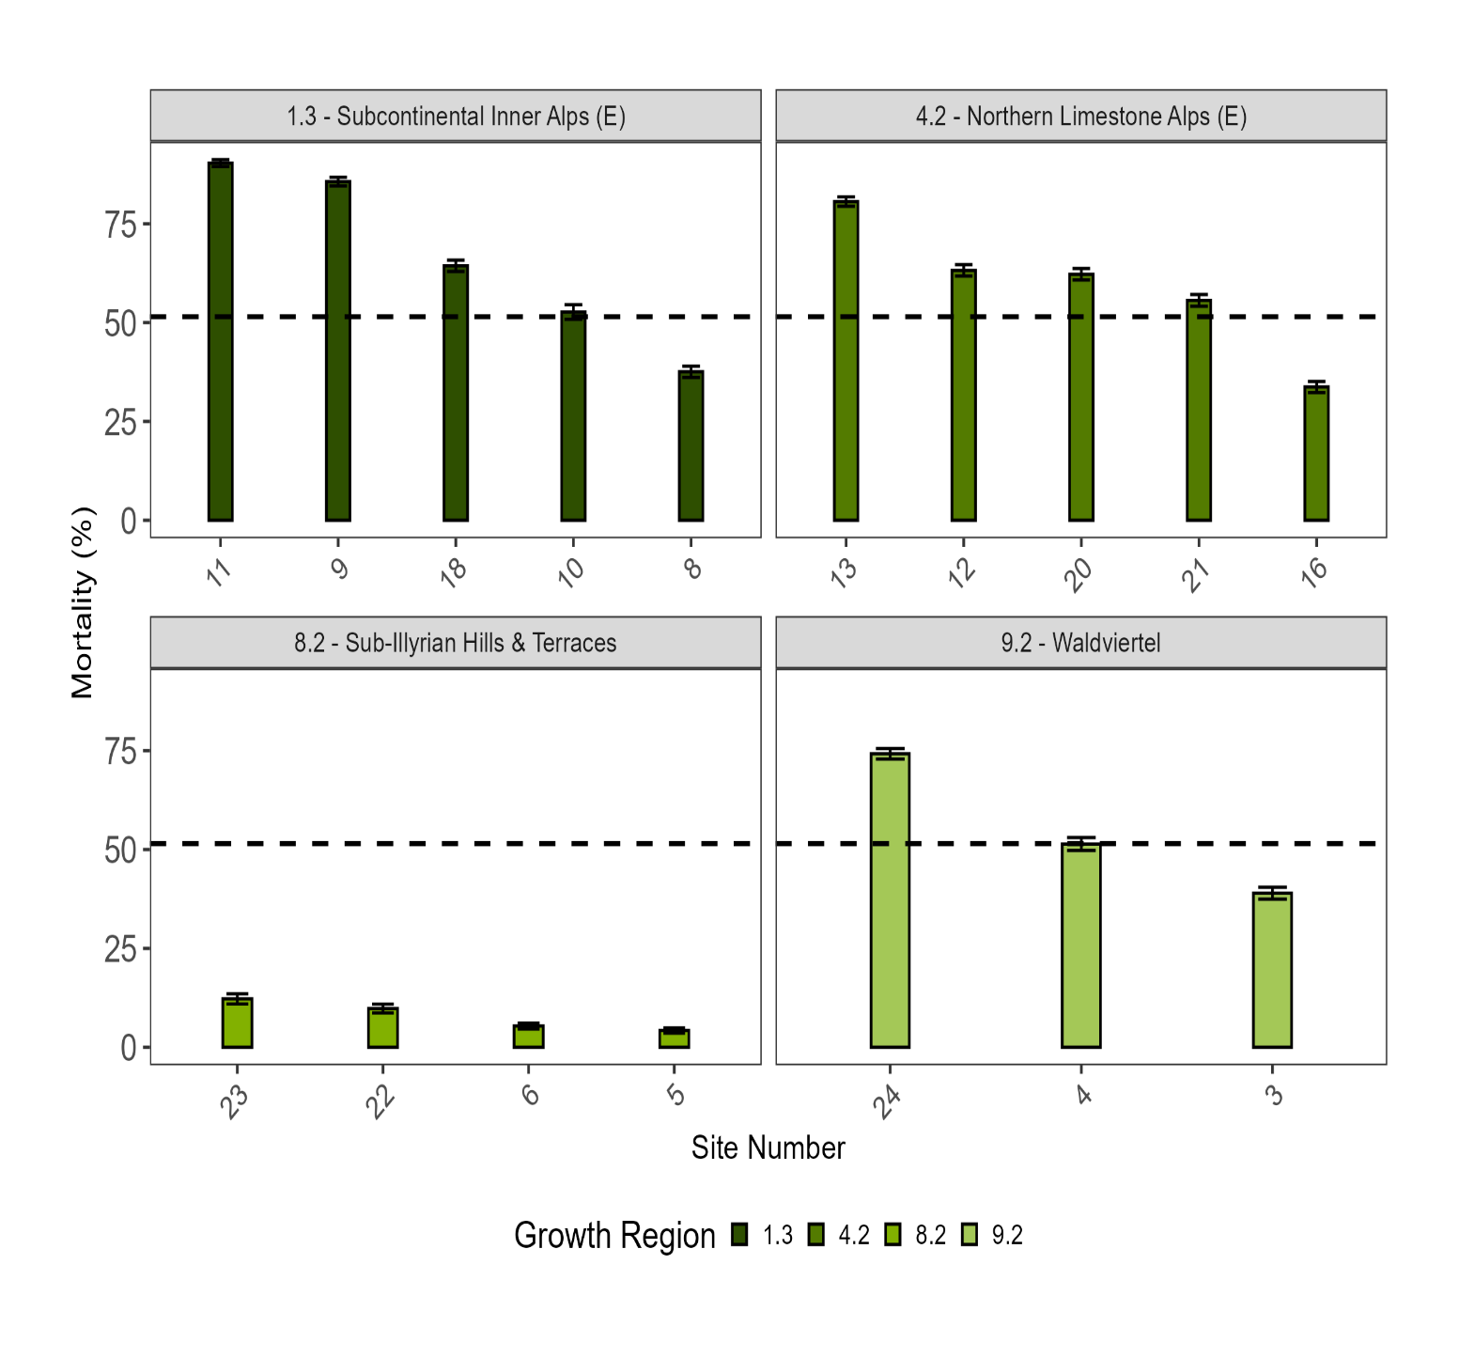
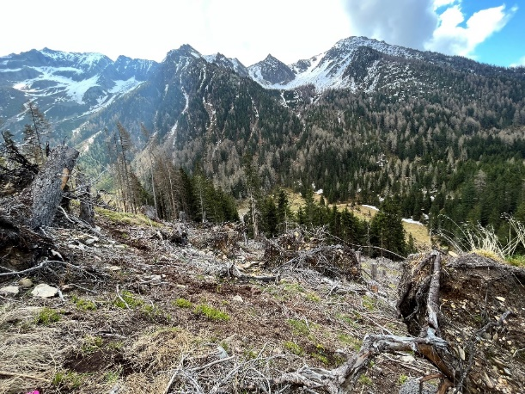
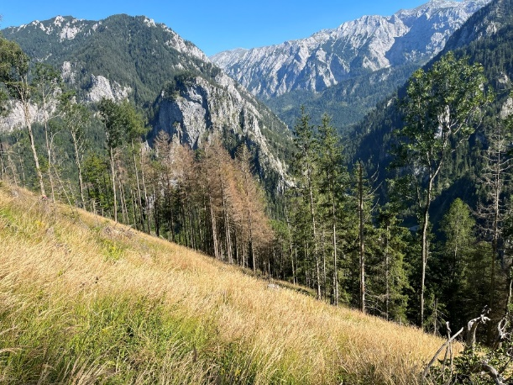
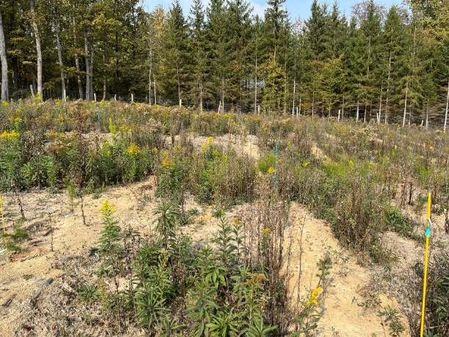
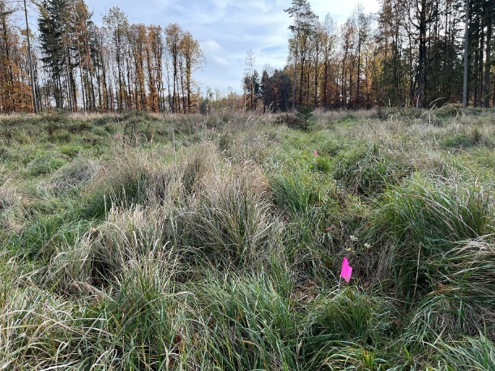
Results: tree seedling mortality rates
Notes:
Looking at the variation in mortality across growth regions, we can see that some areas are moderate, under 50%, but in the high alpine zones losses exceeded 75%. This already tells us: local site conditions strongly influence survival.

Slide 6



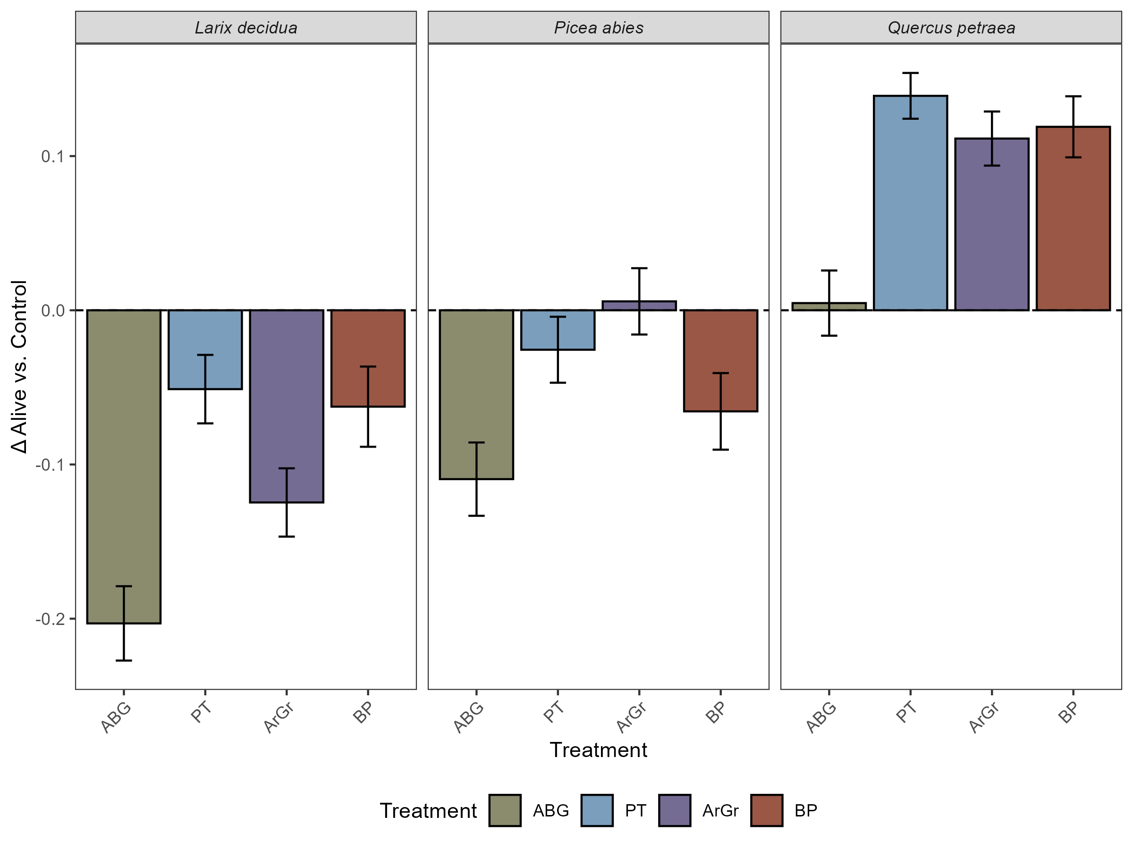
Results: soil amendments
Notes:
Here’s the core result: amendments reduced survival for spruce and larch, but increased it for oak. Same products, opposite outcomes – so clearly the context matters.

Slide 7
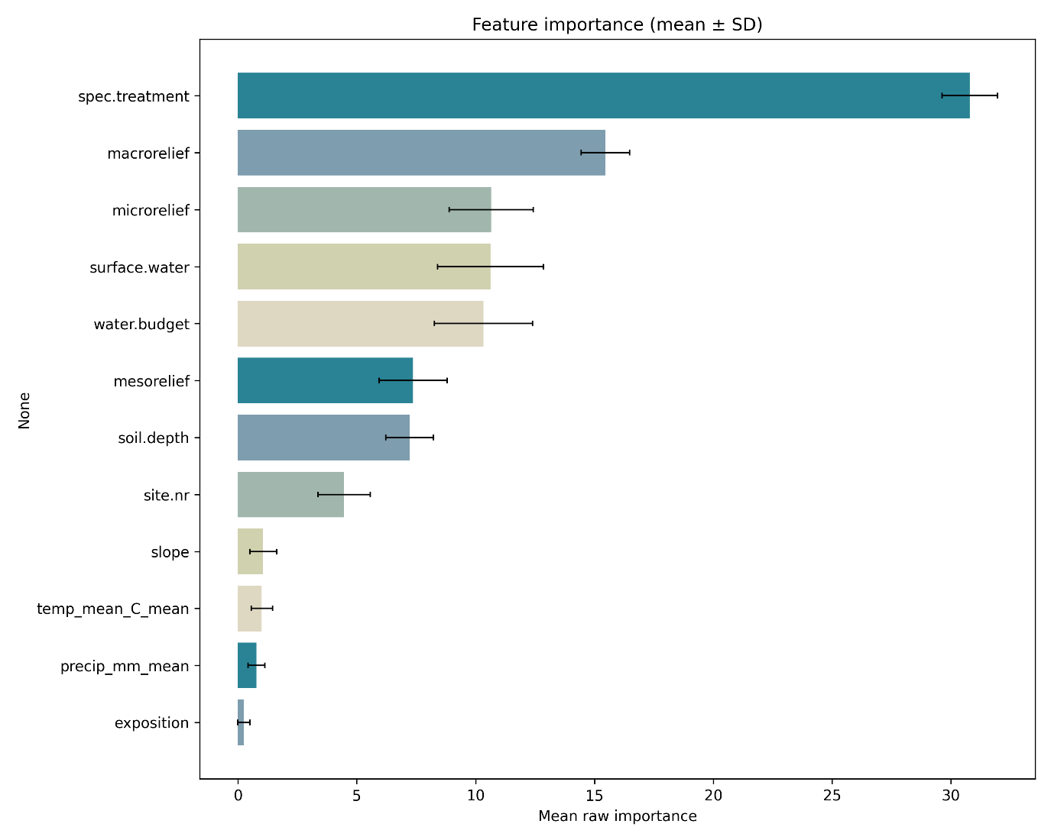
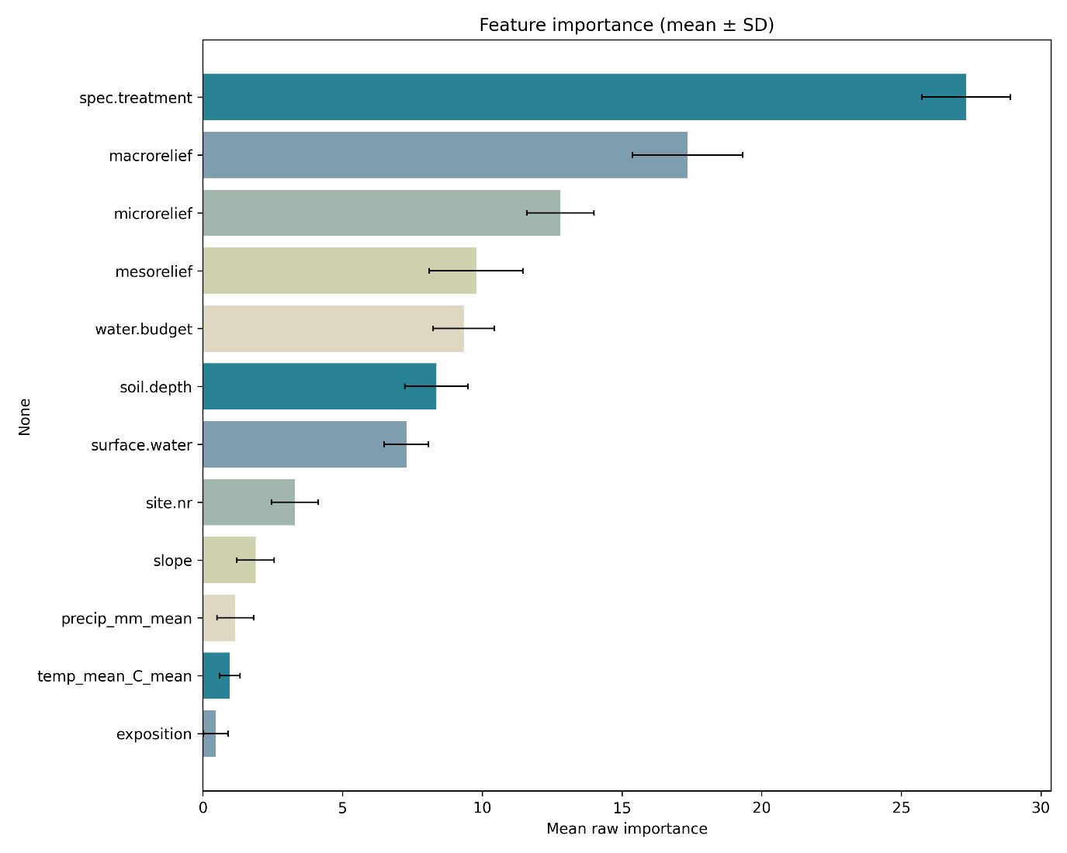
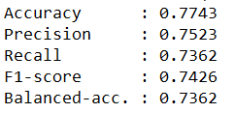
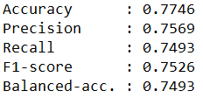
What drives seedling mortality?
soil amendment
soil amendment
macrorelief
microrelief
surface water
mesorelief
water budget
water budget
mesorelief
surface water
Notes:
What we see in the model is that treatment type is by far the dominant driver of mortality. At the same time, microsite conditions and hydrology remain strong and important factors for seedling survival. Climate averages, on the other hand, play only a minor role, which tells us that it’s not so much the regional climate but the immediate site conditions that determine outcomes. What’s interesting is that their relative importance shifts once soil amendments are applied, showing how these interventions interact with the site in often counterproductive ways. The model outcomes are supported by GLMM hypothesis testing and overall underline that survival is mainly governed by how and where seedlings are planted, not by simple add-on treatments.

Slide 8
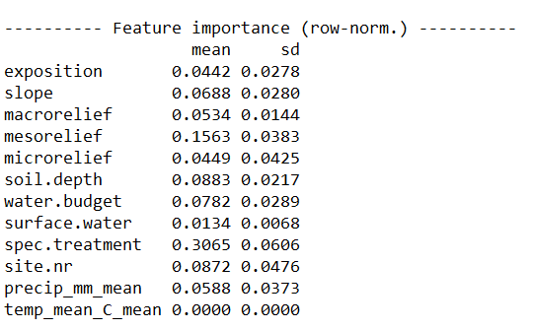
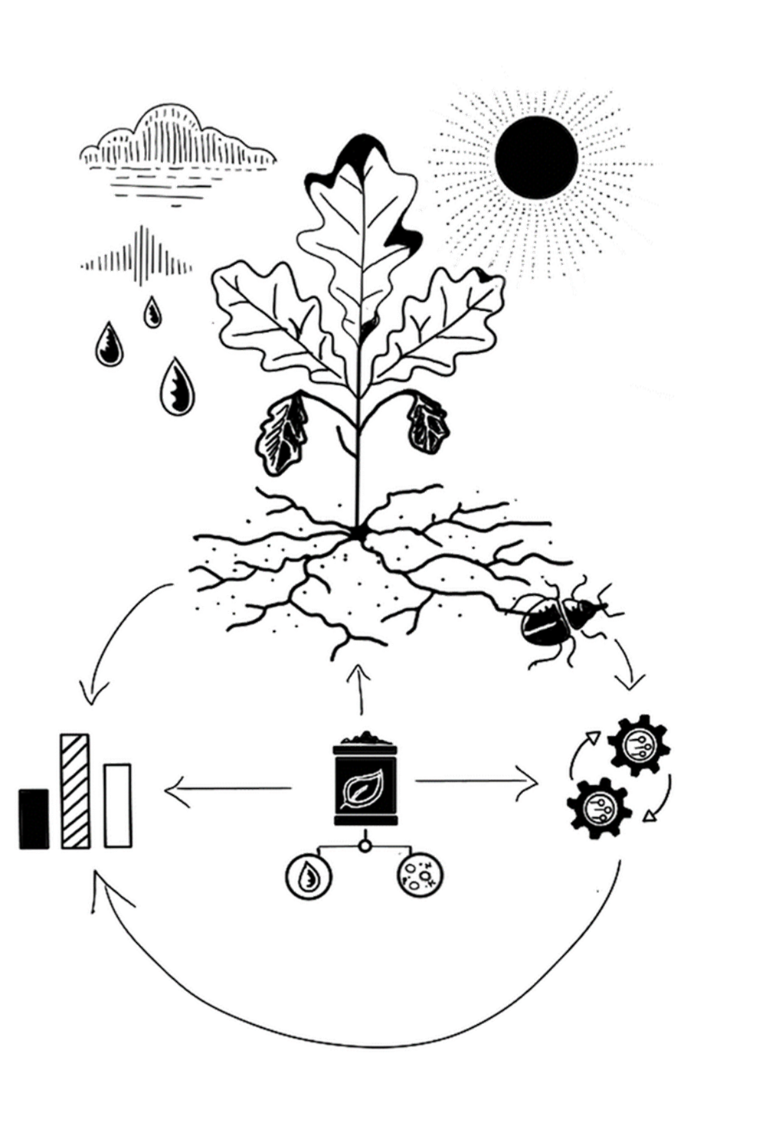
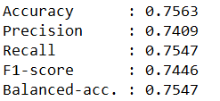
Why did oak like the treatment
Notes:
We’ve looked into why it did not work for larch and spruce now lets investigate why oak showed increased seedling survival when treated with soil amendments. The model shows again that treatment type is the strongest predictor, but here the effect is positive. Mesorelief, soil depth, and even precipitation play a larger role than in the conifers, as well as site specific factors that we didn’t include here (such as soil type eg)

Slide 9
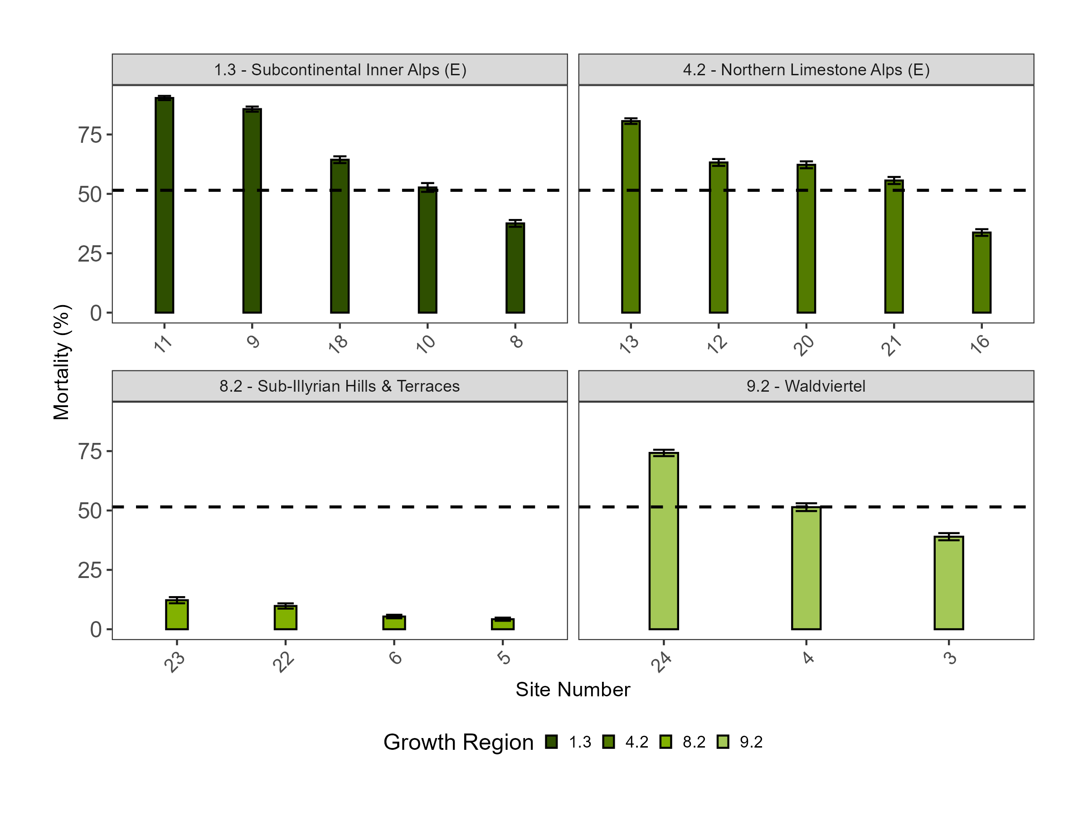
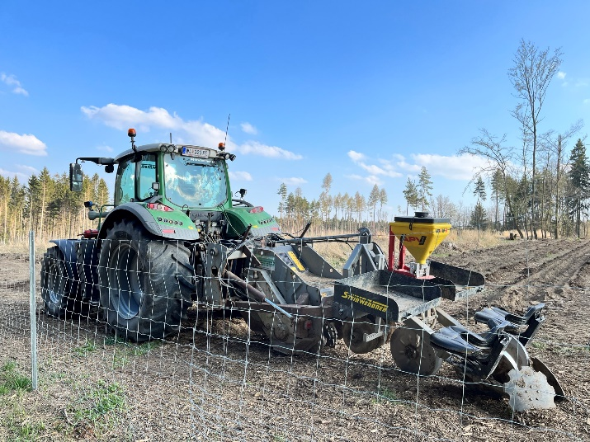
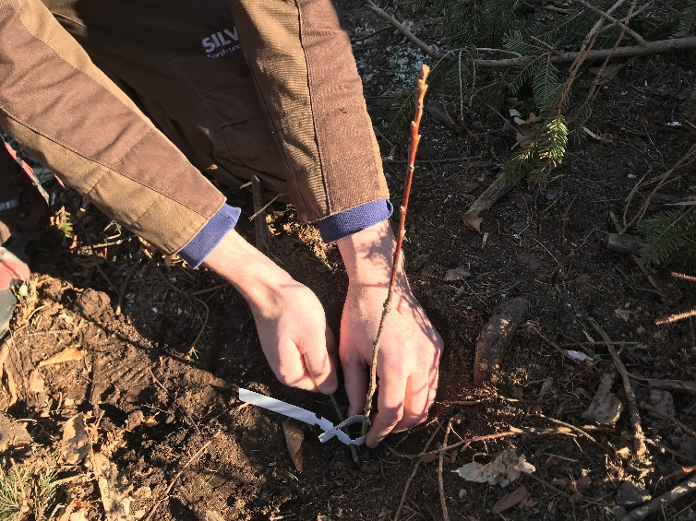
Why did oak like the treatment
Notes:
The different results can be explained by where and how the species were planted. Oak is typically established at lower elevations on deeper, workable soils, where amendments can be incorporated mechanically. In that setting, they actually support seedling establishment. Looking closer, it was only the mechanically planted and amended oaks that showed lower mortality than average — manually planted oaks still performed poorly.
By contrast, spruce and larch in our study were planted by hand on shallow, south-facing alpine soils. Under those harsher conditions, the amendments don’t relieve stress — they concentrate it, leading to higher mortality.

Slide 10
Conclusions
LAB PROMISE, FIELD REALITY
Soil amendments work under controlled conditions – but in the field they often fail or even increase mortality.
CONTEXT MATTERS
species, microsite, and planting method determine whether amendments help or harm.
PATH FORWARD
rethinking forestry operations – invest in microsite preparation and targeted amendment use, rather than blanket application.
Notes:
Lab promise, field reality: amendments work in controlled tests, but in the field they often fail or increase mortality. Context matters: species, microsite, and planting method decide outcomes. The path forward is rethinking operations – invest in microsite preparation and targeted amendment use, rather than blanket application. I’m happy to share data and discuss collaborations – thank you very much.

Slide 11
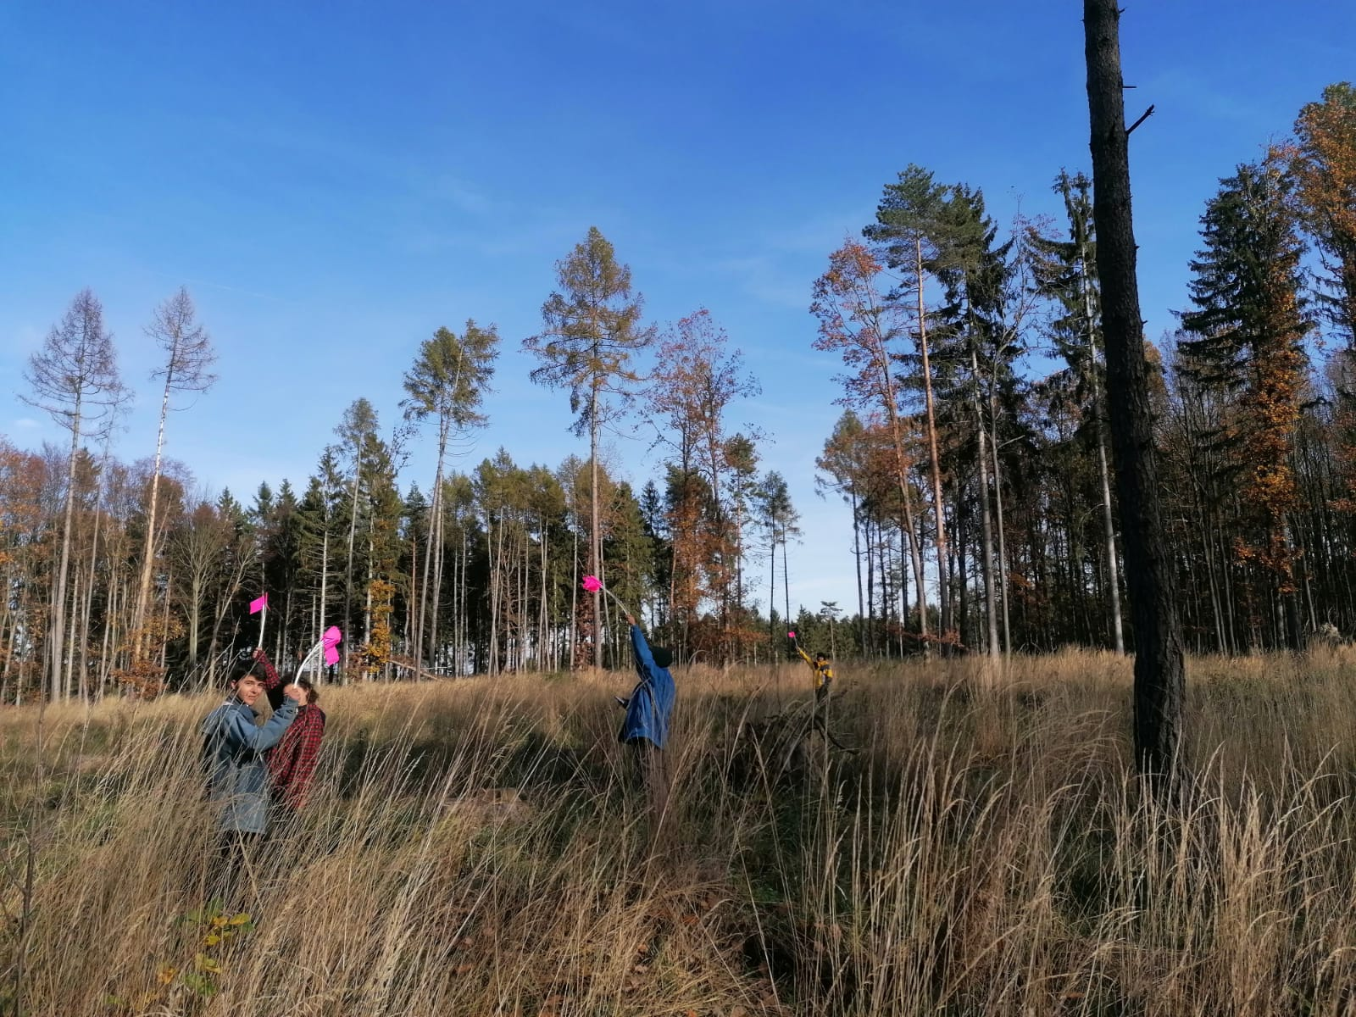






marie.lambropoulos@boku.ac.at
THANK YOU

