Slide 1
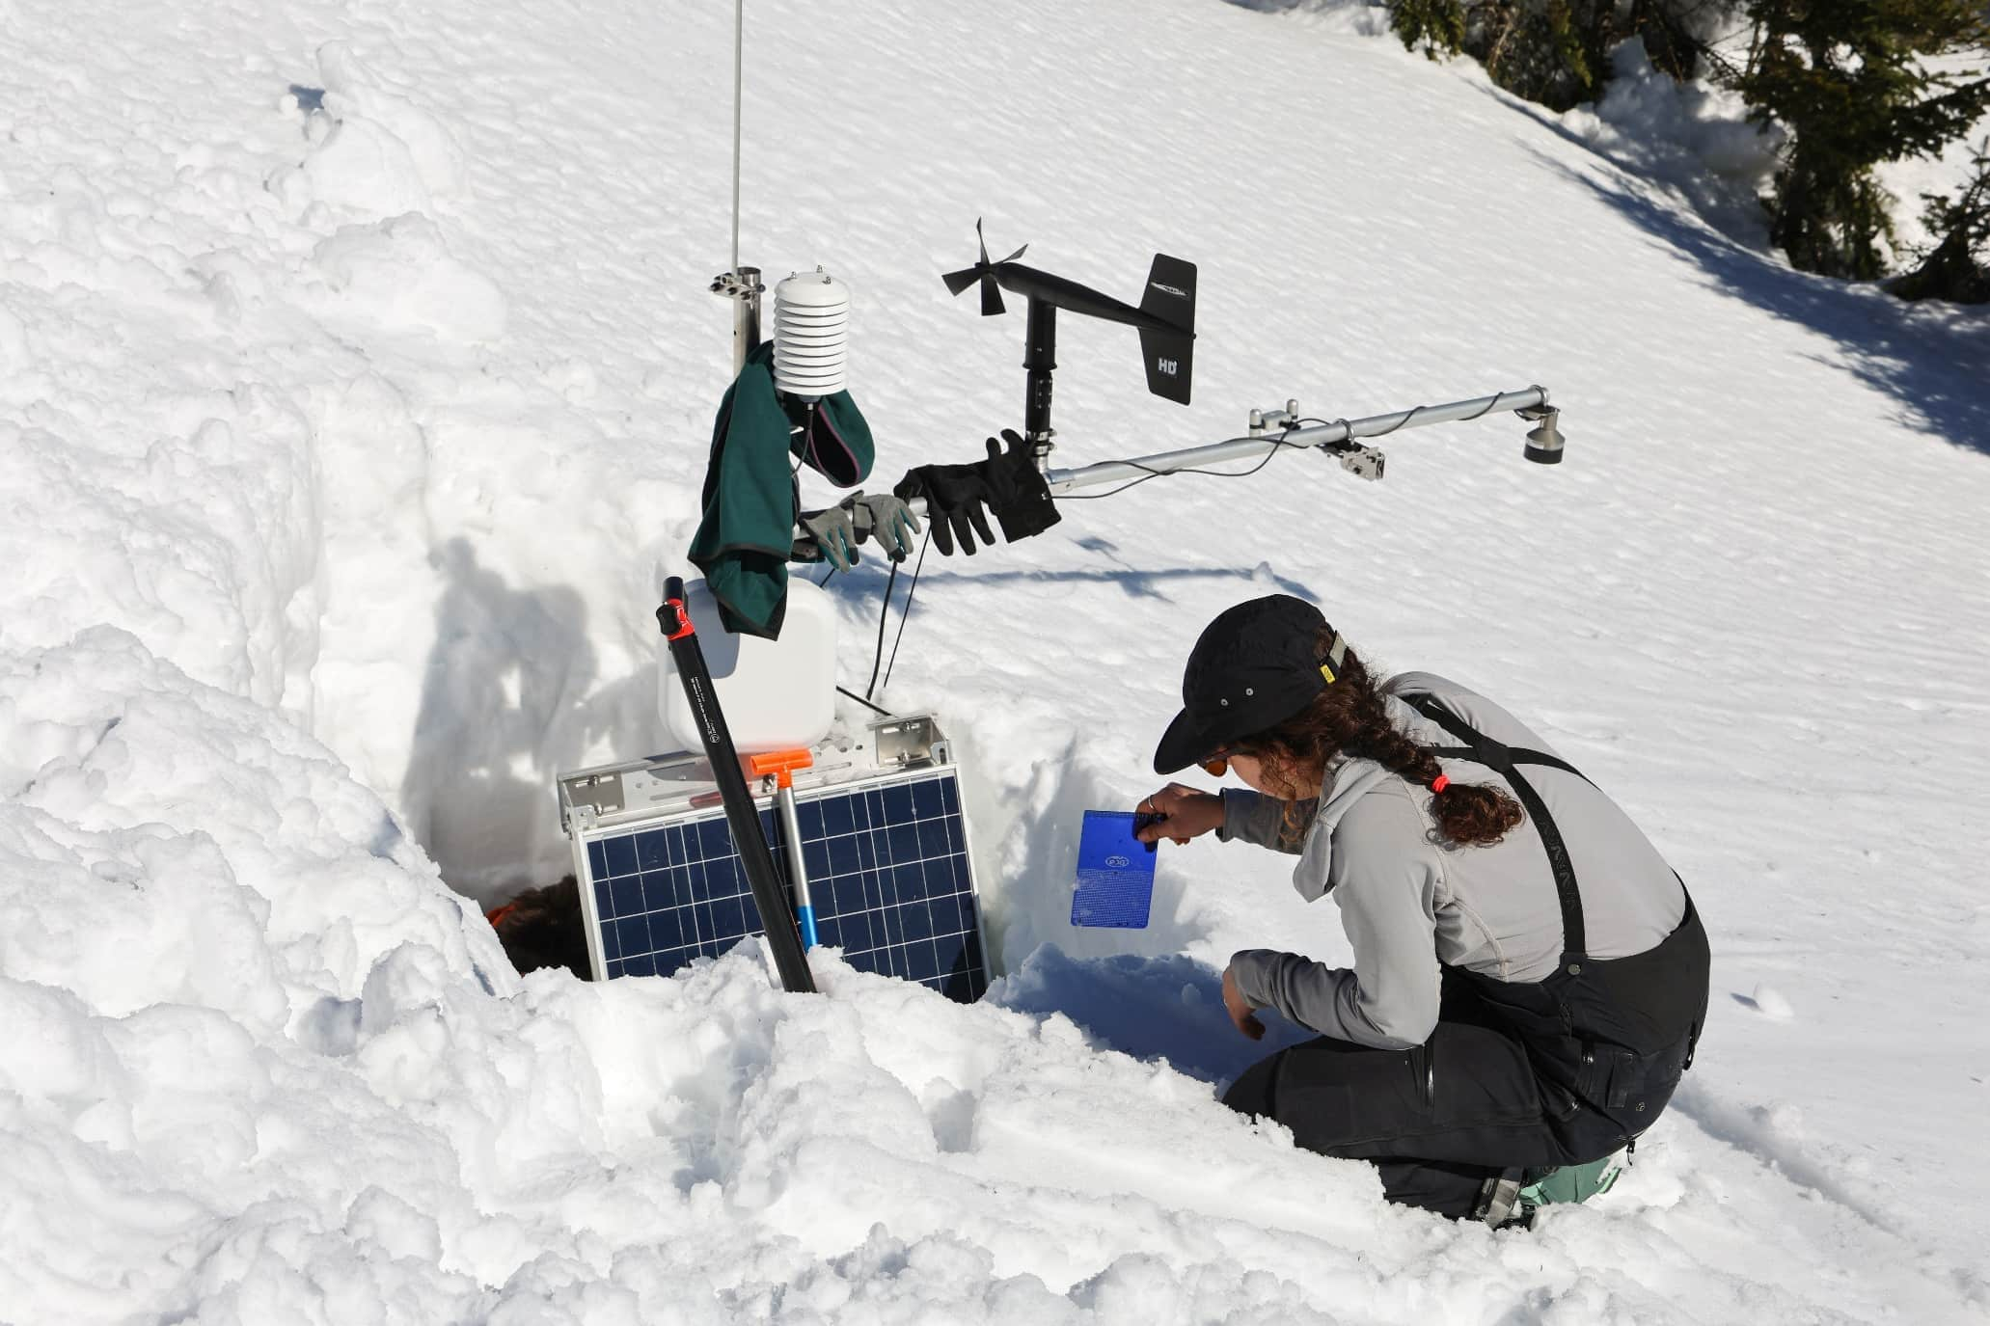

Monitoring Mountain Meteorology and Snow Across Elevational Gradients in the Northeast Appalachians and Adirondacks in North America
Joshua Beneš (1) Mark Beauharnois (2), Arne Bomblies (1), Jay Broccolo (3), Elizabeth Burakowski (4), Paul Casson (2), Jordan Clayton (5), Patrick J. Clemins (1), Alix Contosta (4), Vamsi Dondeti (1), Keith Garret (3), Anna Grunes (1), Heather Hoffman (5), Sara Lance (2), Braedon Lineman (6), Cara McCarthy (5), Scott McKim (2), Justin Minder (2), Colby Morris (3), Georgia Murray (6), Chris Nadeau (7), Sarah Nelson (6), Kyler Phillips (6), Melissa Webb (5)
(1) University of Vermont, Farrell Hall - 210 Colchester Ave, 05465 Burlington, VT USA
(2) Whiteface Mountain Field Station and SUNY-Albany, Wilmington, NY USA
(3) Mount Washington Observatory, North Conway, NH USA
(4) University of New Hampshire, Durham, NH USA
(5) USDA NRCS National Water and Climate Center, Portland, OR USA
(6) Appalachian Mountain Club, Gorham, NH USA
(7) Schoodic Institute, Winter Harbor, ME USA
Notes:
Hello everyone! My name is Joshua Benes, and I am an Associate Director at the University of Vermont’s Water Resources Institute.
It’s an honor to be part of this conversation about recent advances in elevation-dependent climate change.
My talk today focuses less on a single scientific finding and more on a critical approach:
building a regional mountain observatory network to both support local community resilience and contribute to global climate monitoring efforts.
This initiative is a testament to the incredible work of my collaborators, whose names you see listed as co-authors.
I'm excited to share how we're working together to make this regional collaboration a reality, and I hope it may be used as a model for monitoring along elevational gradients worldwide.

Slide 2
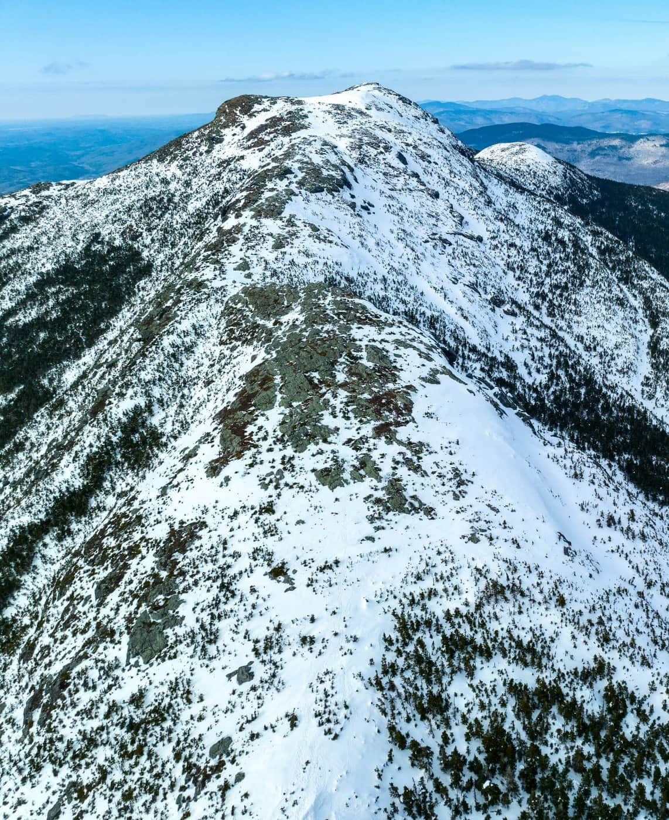
Presentation Outline
Context: Our region has seen unprecedented floods and storms, highlighting critical gaps in weather monitoring.
Our Mission: The Northeast Network of Mountain Observatories (NENMO) is a collaborative effort to improve our understanding of climate change in mountain environments.
Our Work: We are creating a robust network of high-elevation and low-elevation weather stations to improve snowmelt and flood forecasting.
Global Vision: Our standardized approach can serve as a model for global climate monitoring, particularly for understanding elevation-dependent climate change.
Photo Credit: UVM Spatial Analysis Lab
Notes:
Today, I'll begin by sharing some background about why our work is important. I will provide some context about some recent climate-driven events that have impacted our region and highlighted the need for better high-elevation monitoring.
Next, I'll introduce the Northeast Network of Mountain Observatories (NENMO), a collaborative effort designed to fill high-elevation monitoring gaps and improve our forecasting.
Finally, I'll share how NENMO can contribute to a global vision for climate monitoring, particularly regarding elevation-dependent climate change.

Slide 3
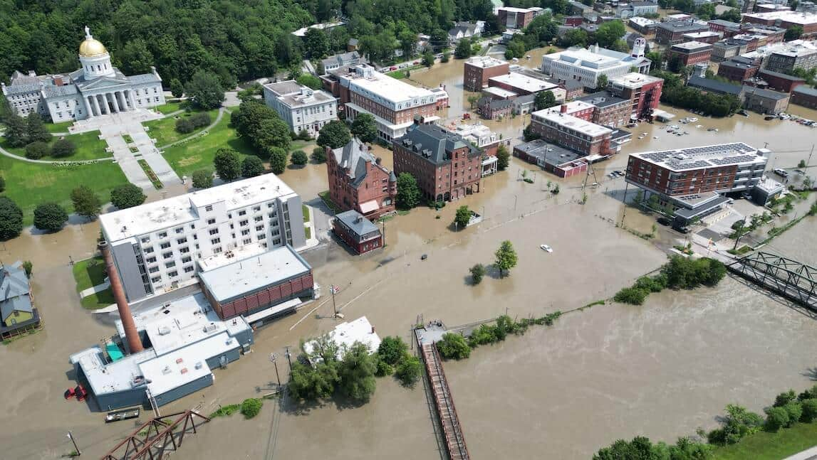
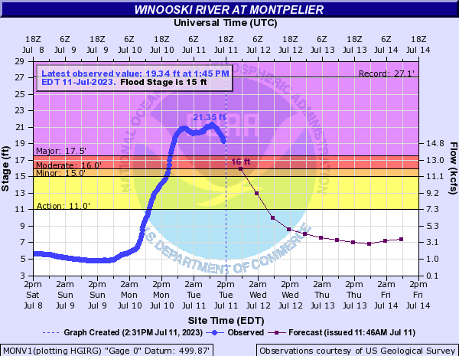
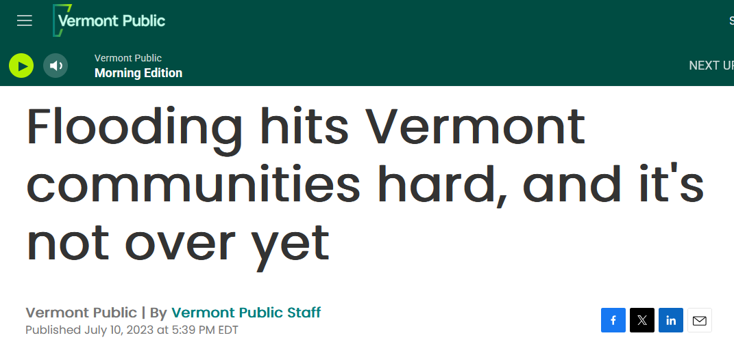
Vermont Flooding Event: July 10th, 2023
Photo Credit:
UVM SAL
Notes:
Over the last 27 months, our region has faced an unprecedented number of extreme weather events. This series of events, including multiple historic floods,

Slide 4
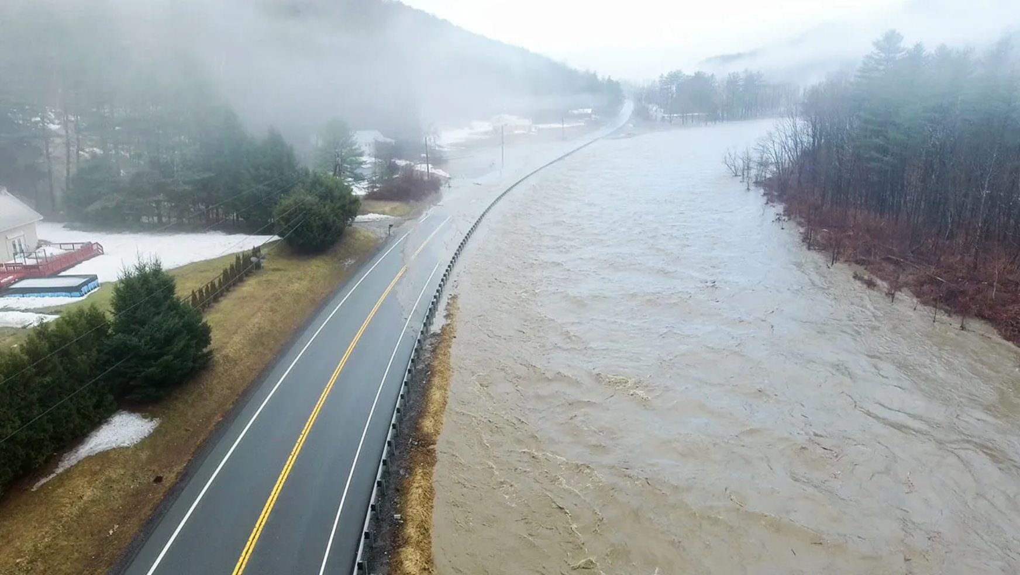

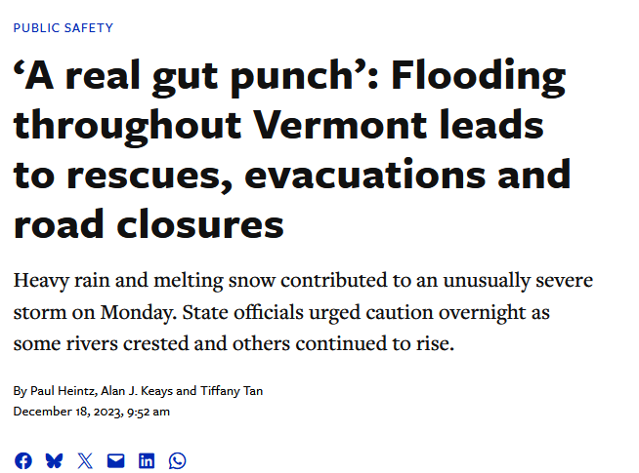
Vermont Flooding Event – (Rain on Snow): December 18th, 2023
Notes:
a rain-on-snow flood, and a powerful windstorm, has highlighted critical gaps in our

Slide 5
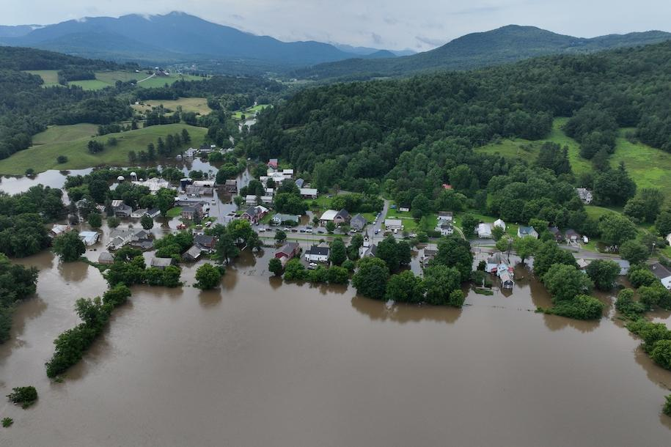
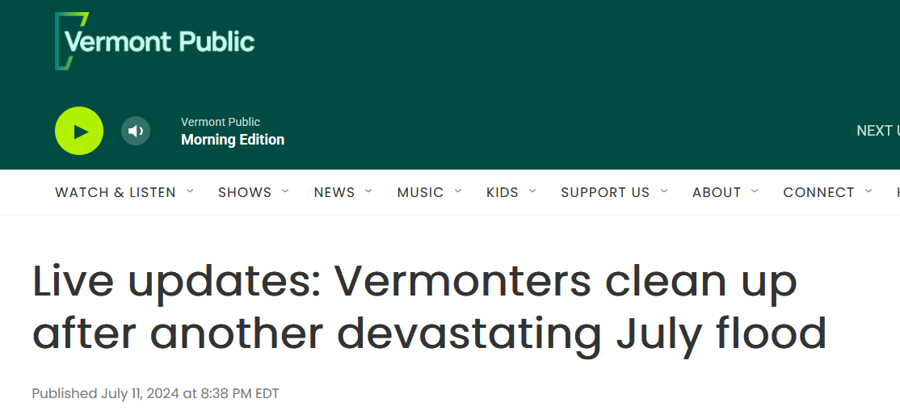
Vermont Flooding Event: July 10th, 2024
Photo Credit:
UVM SAL
Notes:
regional weather monitoring capabilities - particularly at higher elevations. These events have caused significant property losses,

Slide 6
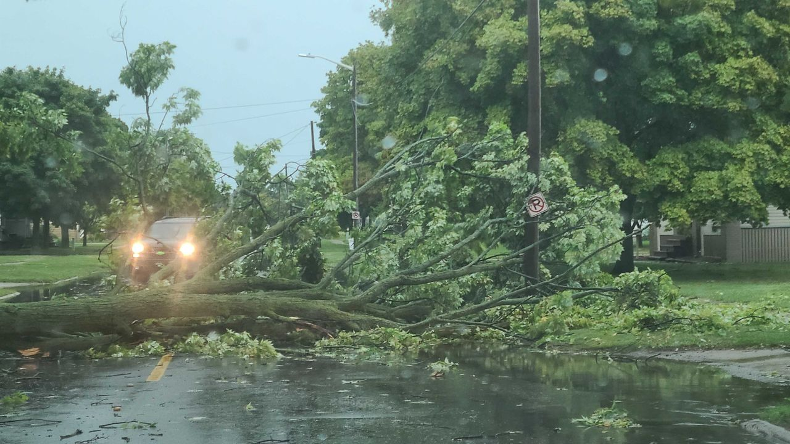
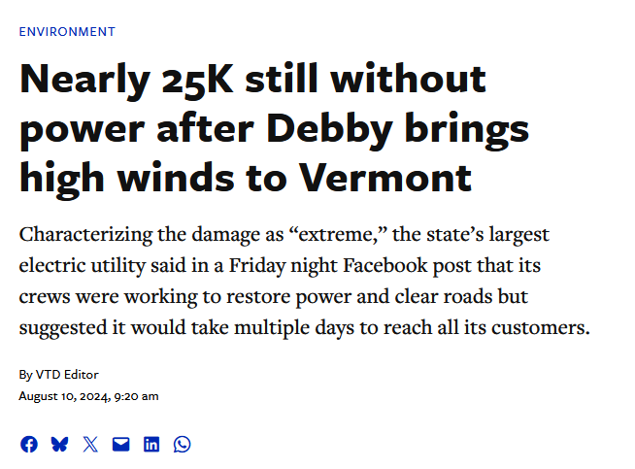
Vermont Flooding and Windstorm: August 27th, 2024
Photo Credit:
Phil Wilson
Notes:
economic disruption, and power outages. They serve as a powerful reminder of the urgent need

Slide 7
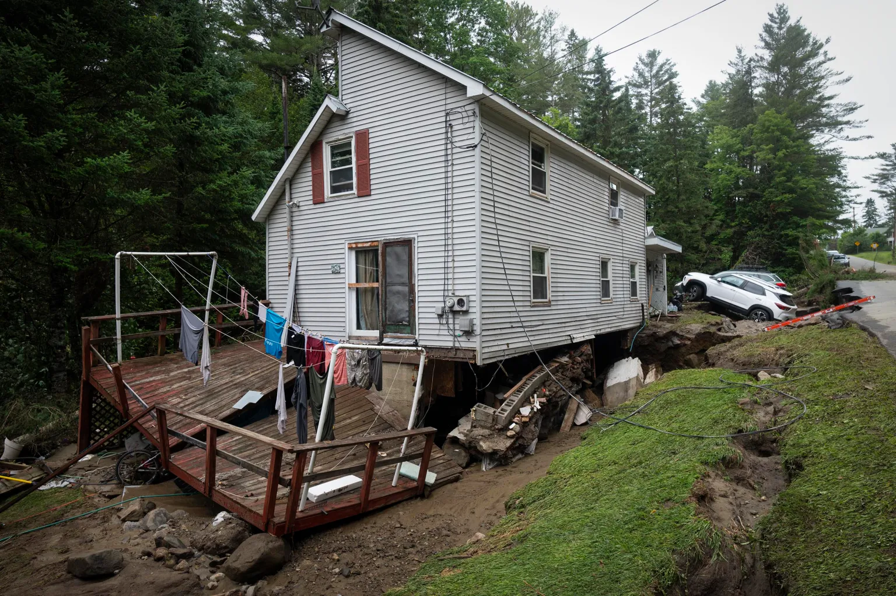
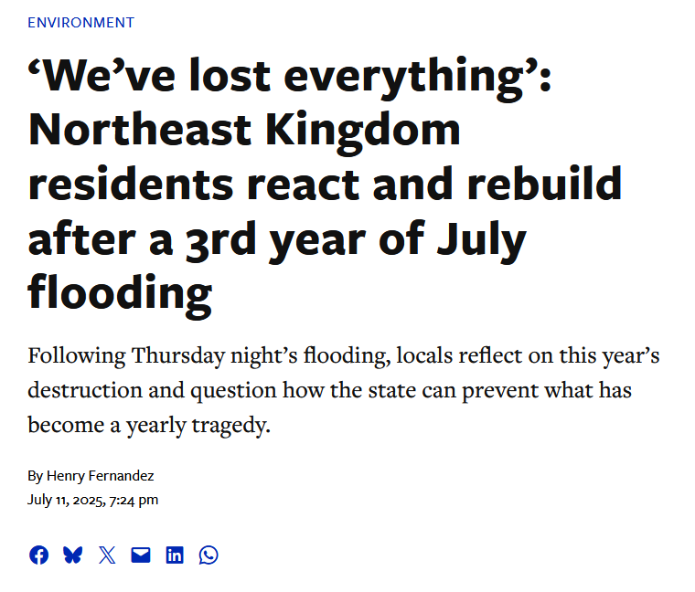
Vermont Flooding Event: July 10th, 2025
Photo Credit:
Glenn Russell/VTDigger
Notes:
for real-time weather, precipitation, and snow monitoring across our region so that our communities can stay informed and respond accordingly to these events.

Slide 8
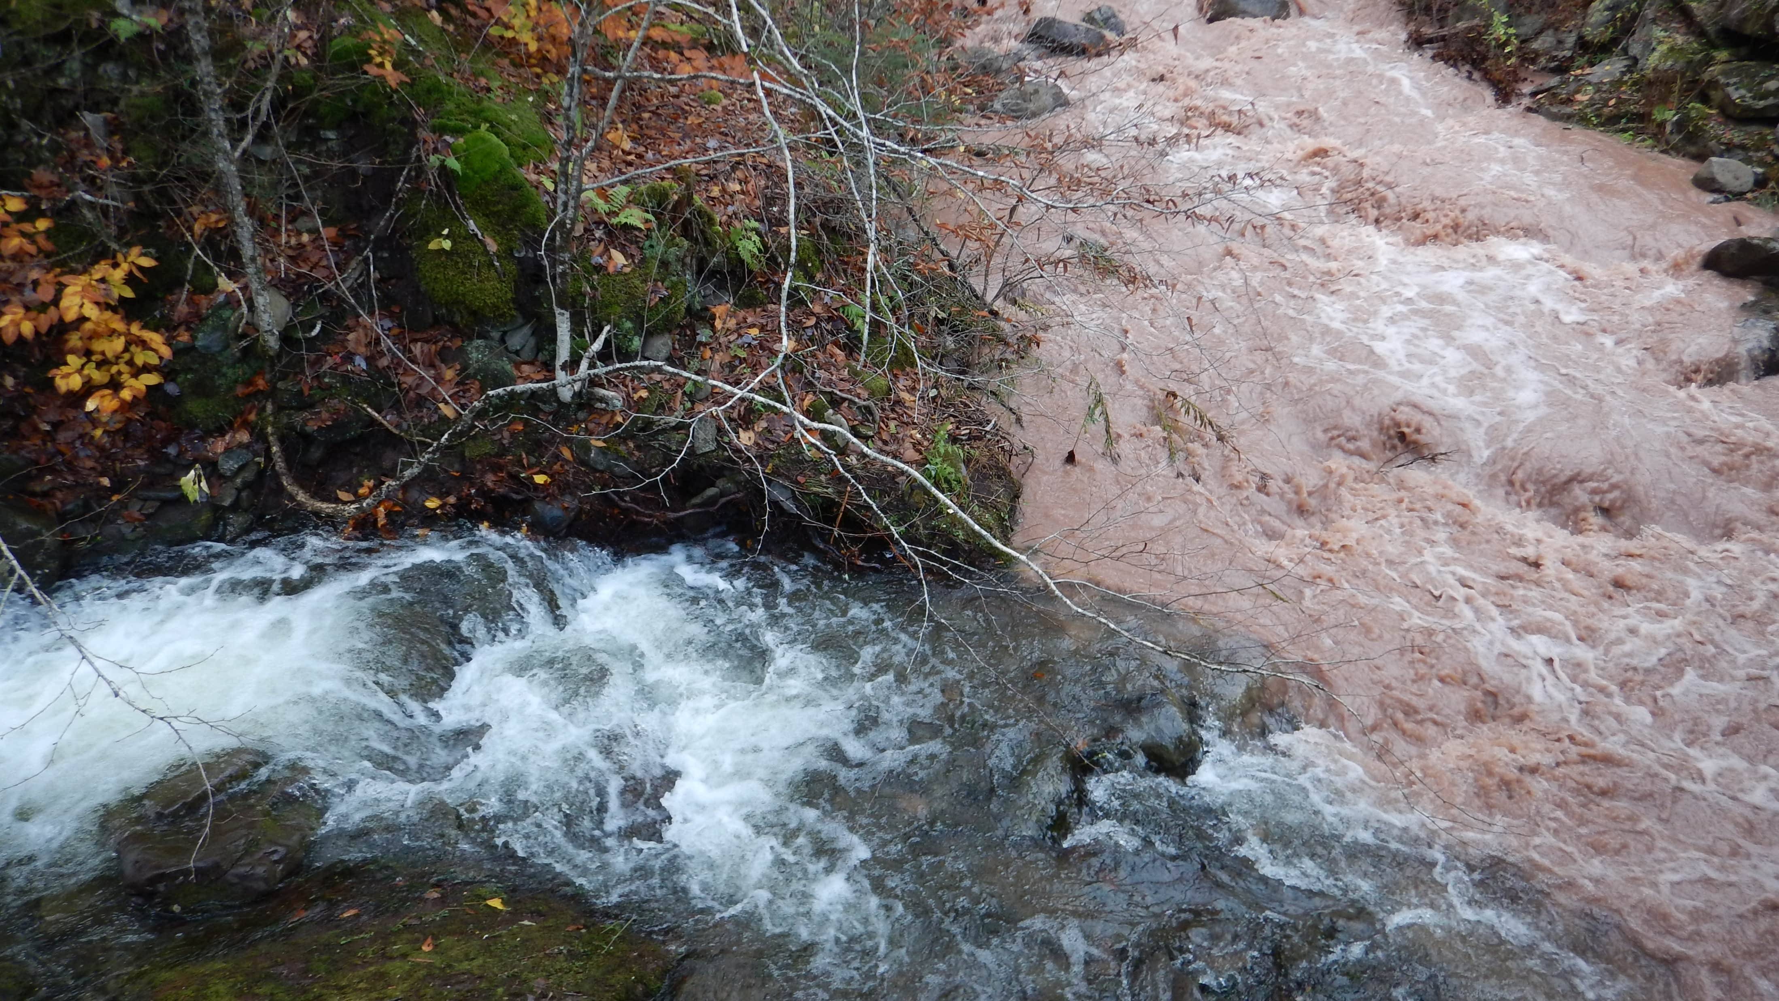
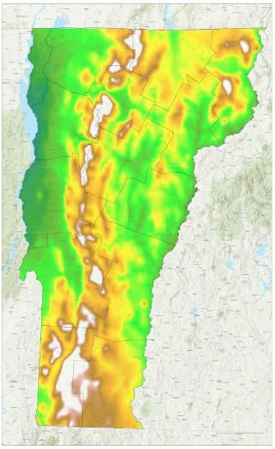
This map illustrates that the highest annual precipitation in Vermont occurs along the high-elevation spine of the Green Mountains, which runs north to south across the state.
Most of the Northeast’s precipitation falls in the mountains, but we lack the coordinated infrastructure to properly monitor it.
Automated data for snow, rain, river levels, and temperature changes is needed to enhance regional weather forecasts.
Real-time data is critical for emergency personnel to help keep our communities safe.
Notes:
Now, this is where the challenge lies: most of the Northeast’s precipitation falls in the mountains, but we currently lack the coordinated infrastructure to properly monitor it.
To enhance regional weather and flooding forecasts, we urgently need automated data for snow, rain, and temperature changes.
We need to work to ensure any real-time data we collect in our mountainous regions is accessible to emergency personnel, utility providers, and forecasters so that they can respond accordingly to keep our communities safe.

Slide 9
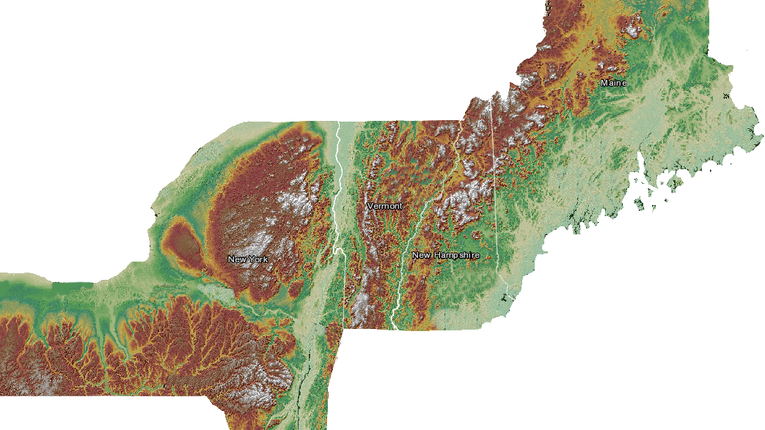
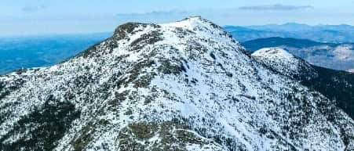



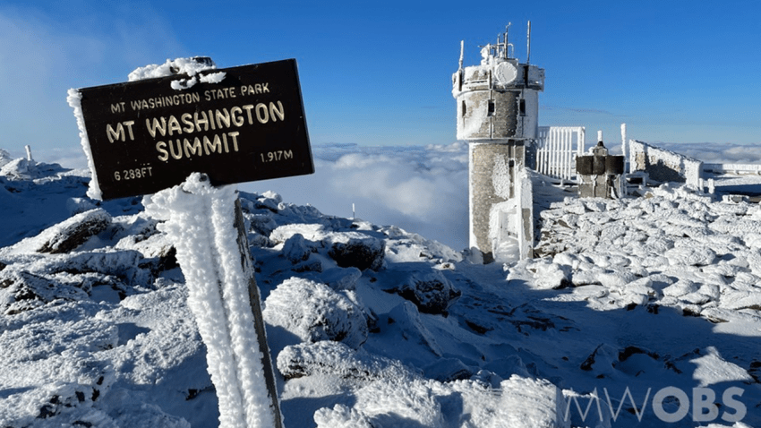


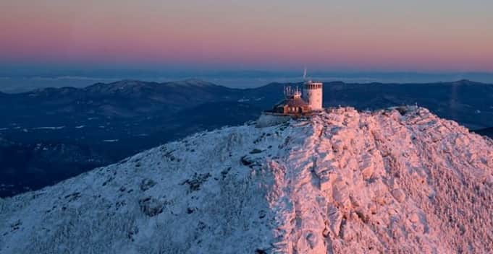



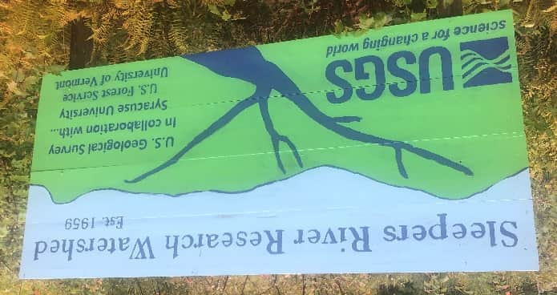

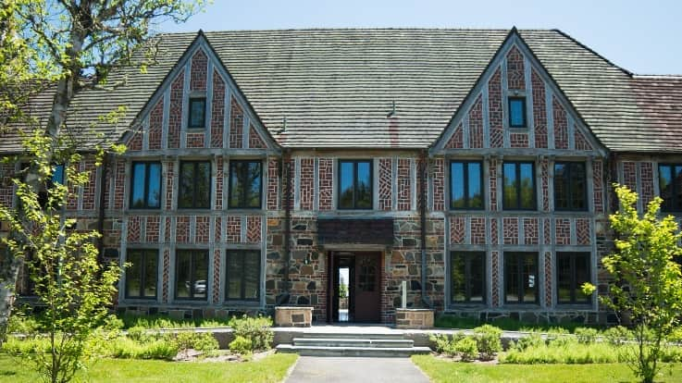
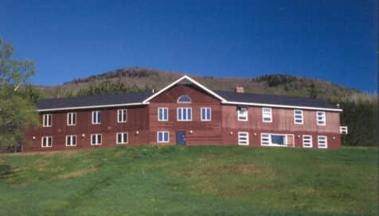
NorthEast Network of Mountain Observatories
Mount
Washington
Observatory
Mount Mansfield
Natural Area
Photo credit: Mount Washington Observatory
Atmospheric Sciences
Research Center
Photo credit: Brad Crosby
Kitteridge Hills: Sleepers
River Research Watershed
Photo credit: Schoodic Institute
Photo credit: Hubbard Brook Ecosystem Study
Background map credit: Renee Vieira Farnsworth, NALCC
Notes:
Partners involved with key monitoring projects in our region have been working together to establish a Northeast Network of Mountain Observatories (NENMO).
I have been facilitating regular meetings between all of these mountain observatories and key partners.

Slide 10

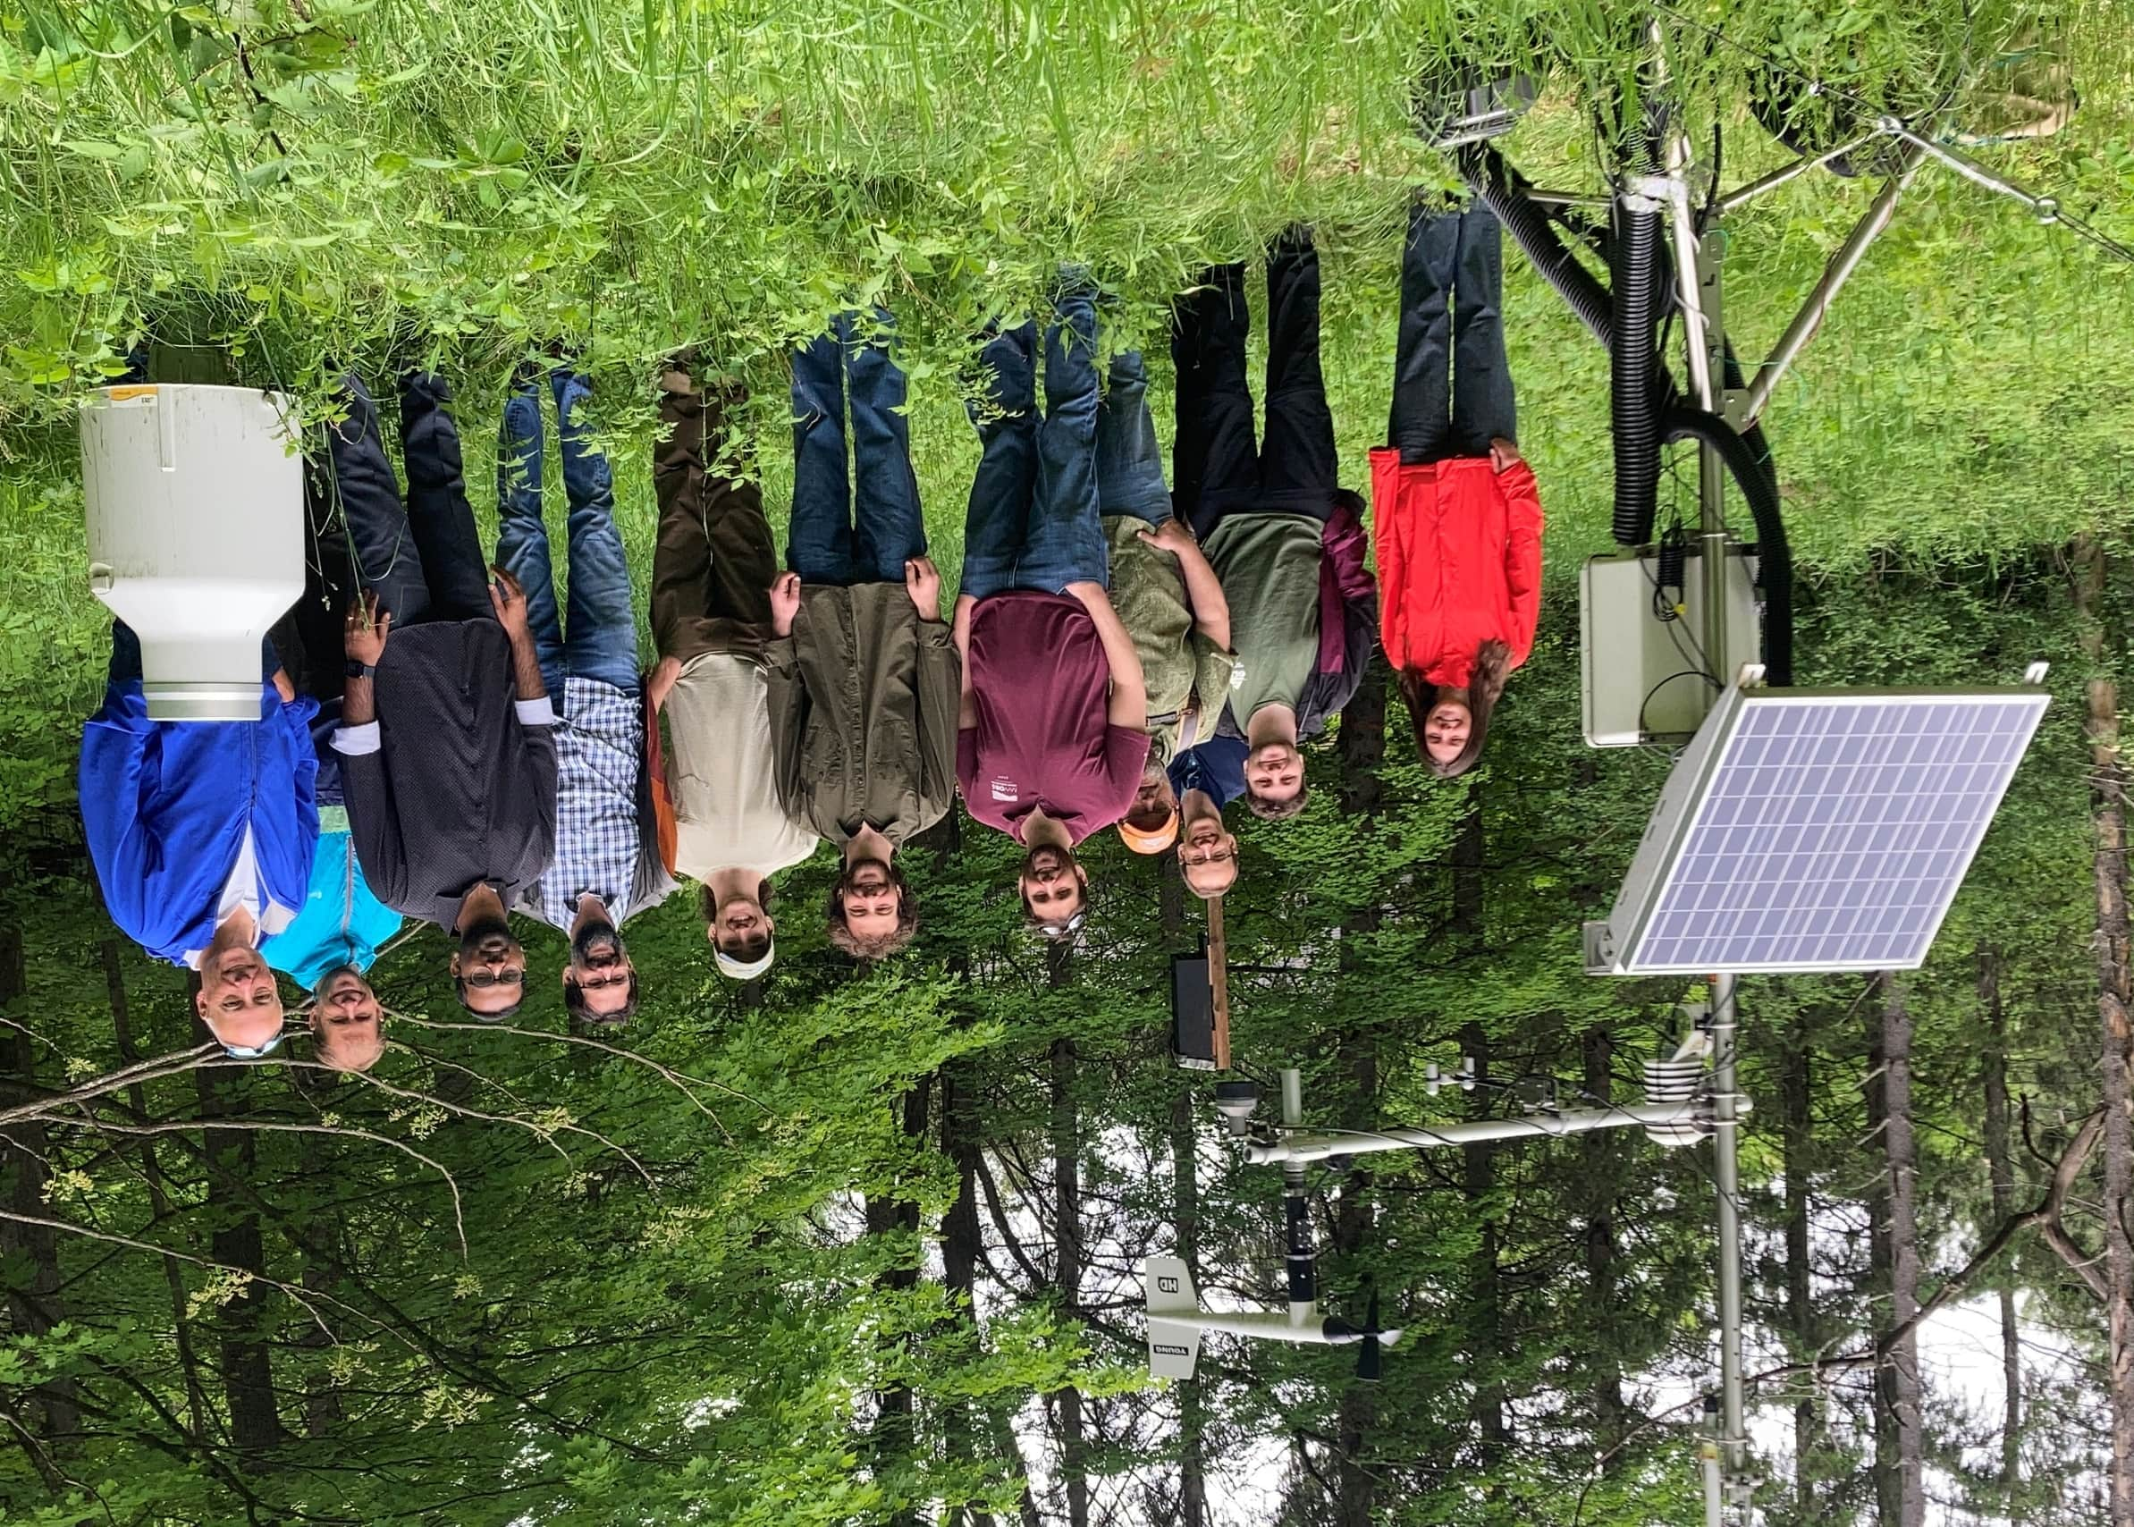
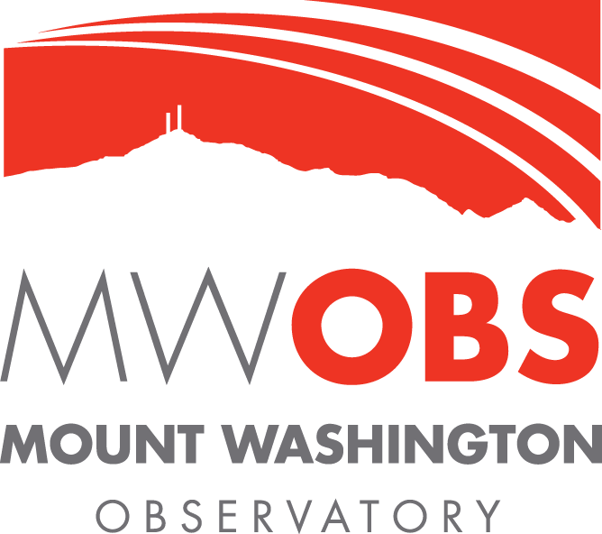

NENMO Environmental Network Project
Notes:
The first NENMO initiative I'll discuss is developing the foundation for a coordinated, networked, and regional mountain observatory network.
I will briefly summarize each of these observatories now and then provide information about our Environmental Network project to establish a cohesive regional monitoring system.

Slide 11
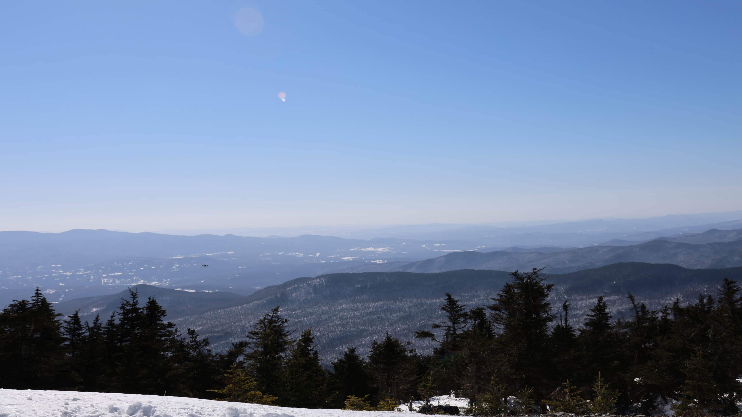
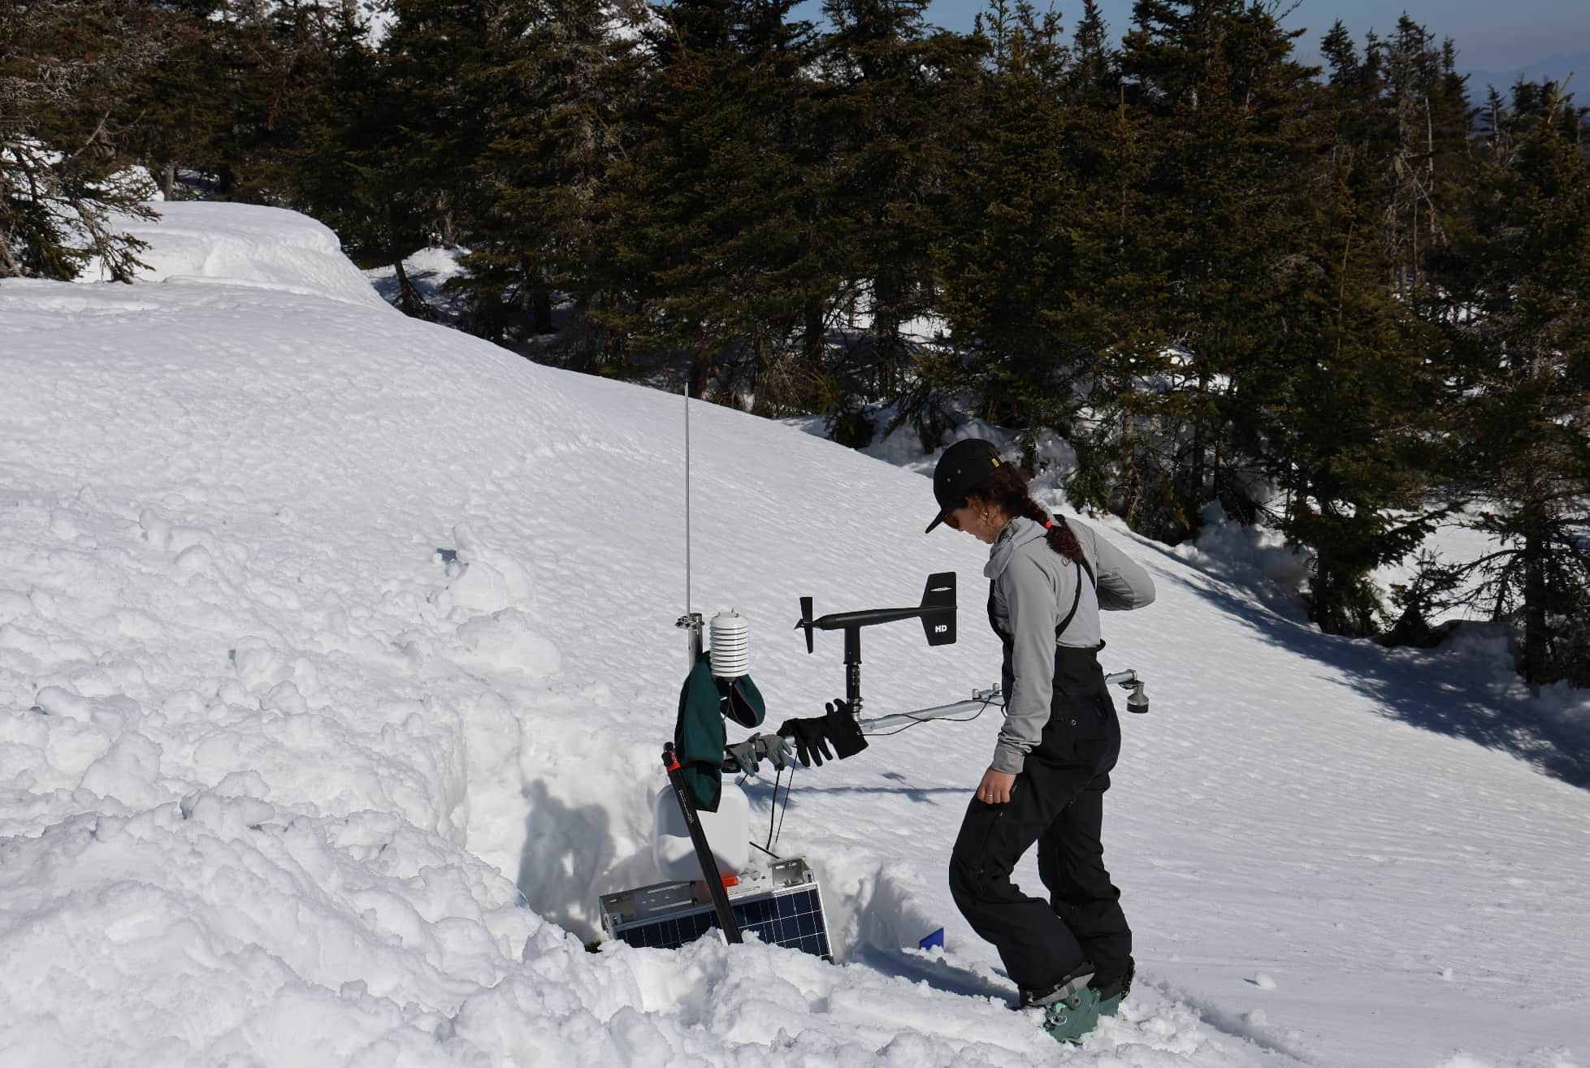
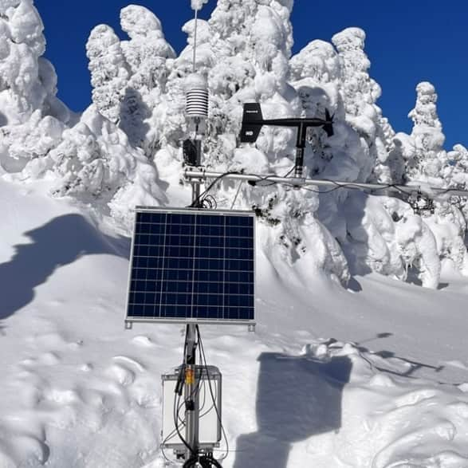
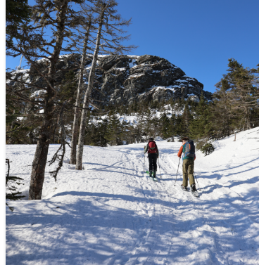
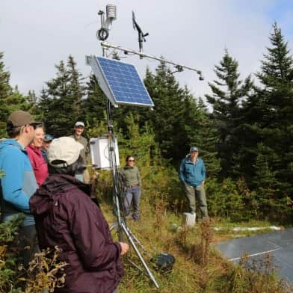
Mount Mansfield & UVM’s Summit to Shore Project
Long-term observation: A weather and snow monitoring record dating back to the 1950s.
Stream gauging: Hydrological record going back to 2000.
Weather Stations: New weather stations along elevational gradients installed in 2022.
Water Focus: Understanding snowmelt & flood impacts.
Notes:
The University of Vermont's Summit to Shore Project, funded by the US Cold Regions Research and Engineering Laboratory, aims to better understand snowpack characteristics and compare them with aerial imagery.
We're leveraging this network to also understand the hydrological responses to melting snow at high elevations.
The majority of the network's weather stations are on Mount Mansfield, the highest mountain in the State of Vermont.
The mountain also hosts a weather and snow record dating back to the 1950s and a long-term hydrological record dating to 2000.

Slide 12
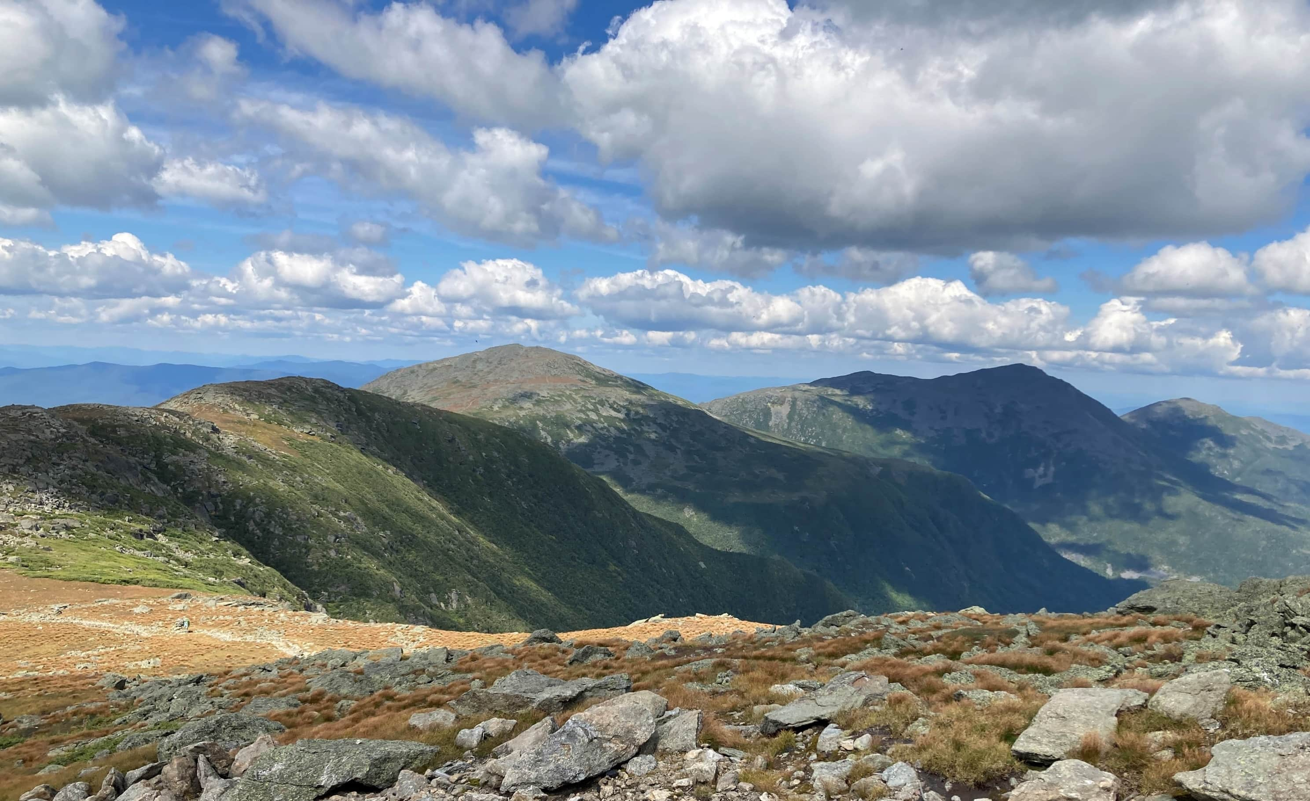
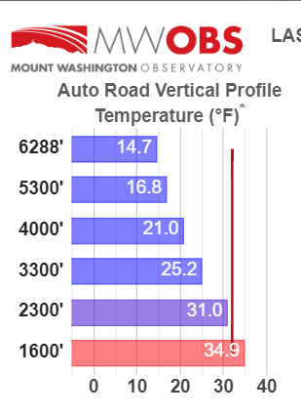
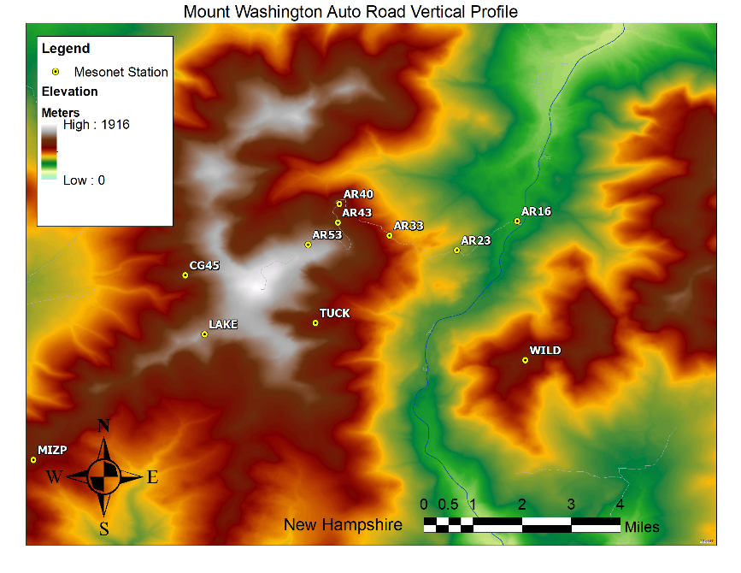
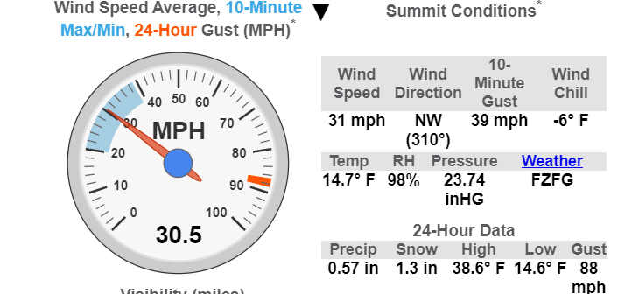
Mount Washington Observatory
Photo credit: Mount Washington Observatory
Summit Observation: A long-term record of manual weather observations has been collected on the summit since 1932.
Mount Washington Regional Mesonet: A network of remote stations collects continuous weather data throughout the White Mountains.
Figure Credits: Mount Washington Observatory
Notes:
The Mount Washington Observatory is a world-renowned, independent nonprofit famous for its extreme weather monitoring and historical meteorological record dating back to 1932.
The nonprofit also manages a regional mesonet, or network of weather stations, along elevational gradients on both sides of the mountain and on neighboring peaks.

Slide 13
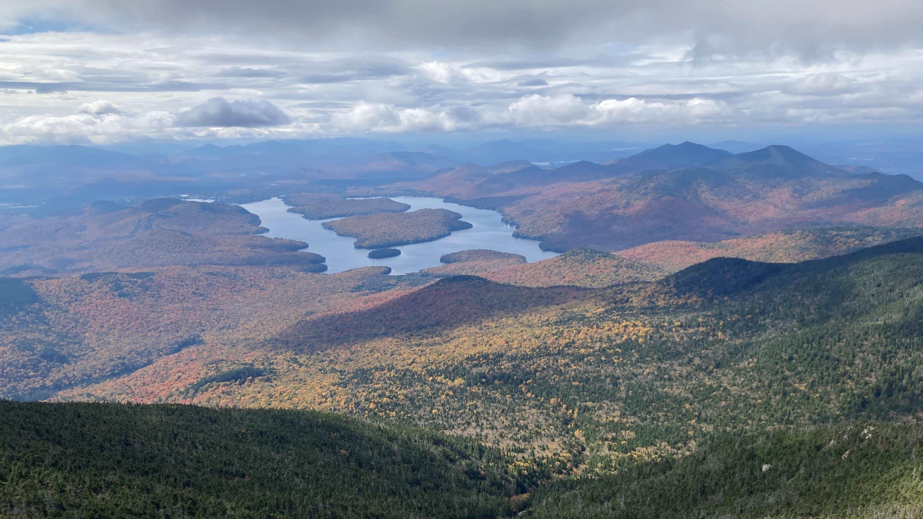
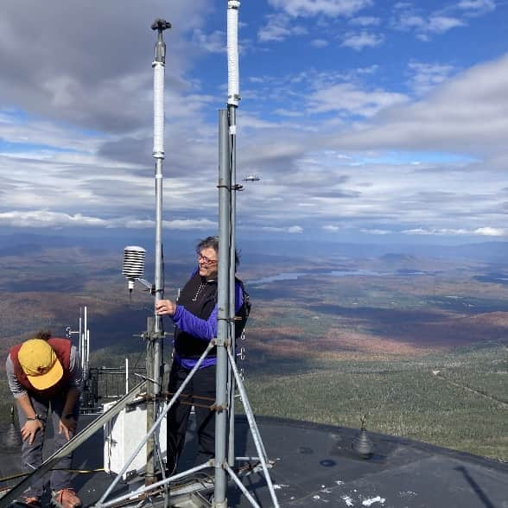
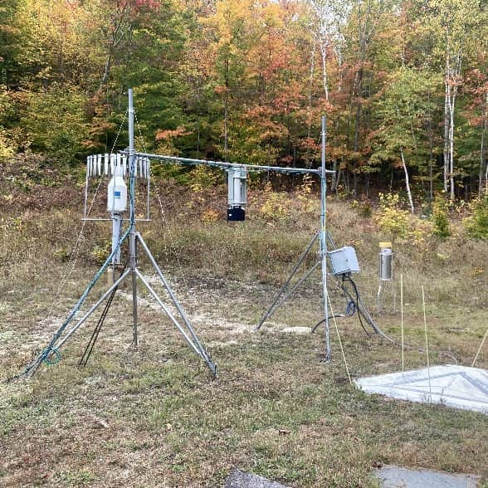
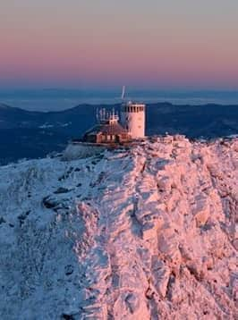
Atmospheric Sciences Research Center: Whiteface Mountain in New York
Summit Observation: Long-term meteorological data since the 1930s.
Weather Monitoring: Measures a wide range of atmospheric conditions, including temperature, wind, and cloud chemistry, vital for climate and air quality research.
Hydrological Monitoring: Stream flow, precipitation, and snow observation at the base.
Photo credit: Brad Crosby
Notes:
The Atmospheric Sciences Research Center on Whiteface Mountain in New York also has a weather record dating back to the 1930s.
Their Center measures a wide range of atmospheric conditions and is particularly well known for their cloud chemistry and air quality research.
Like Mount Mansfield, Whiteface Mountain also has a stream gauge at the base of the mountain for hydrological monitoring.

Slide 14
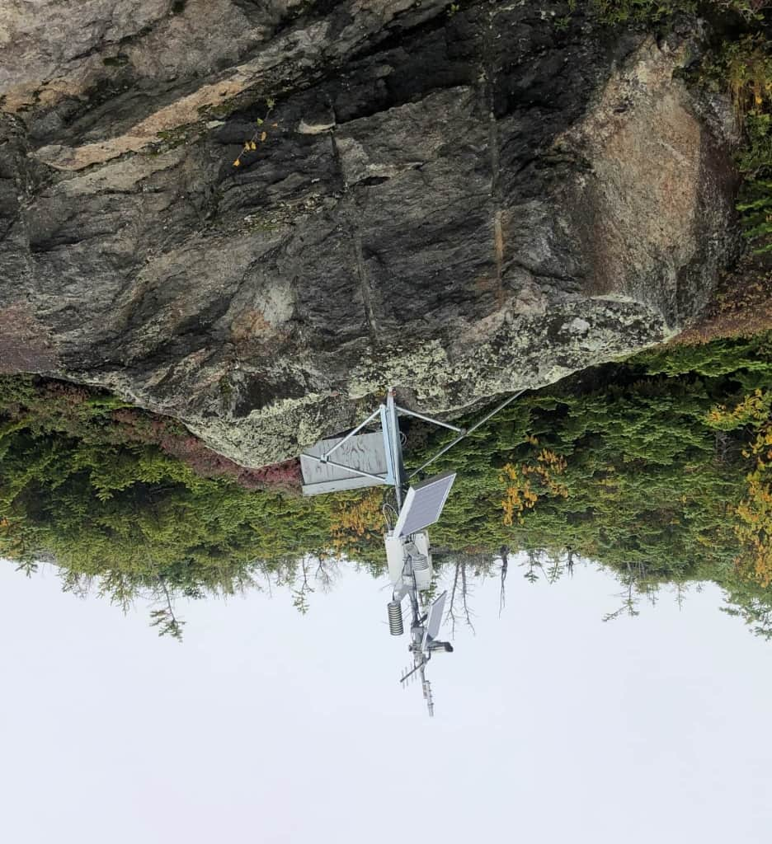
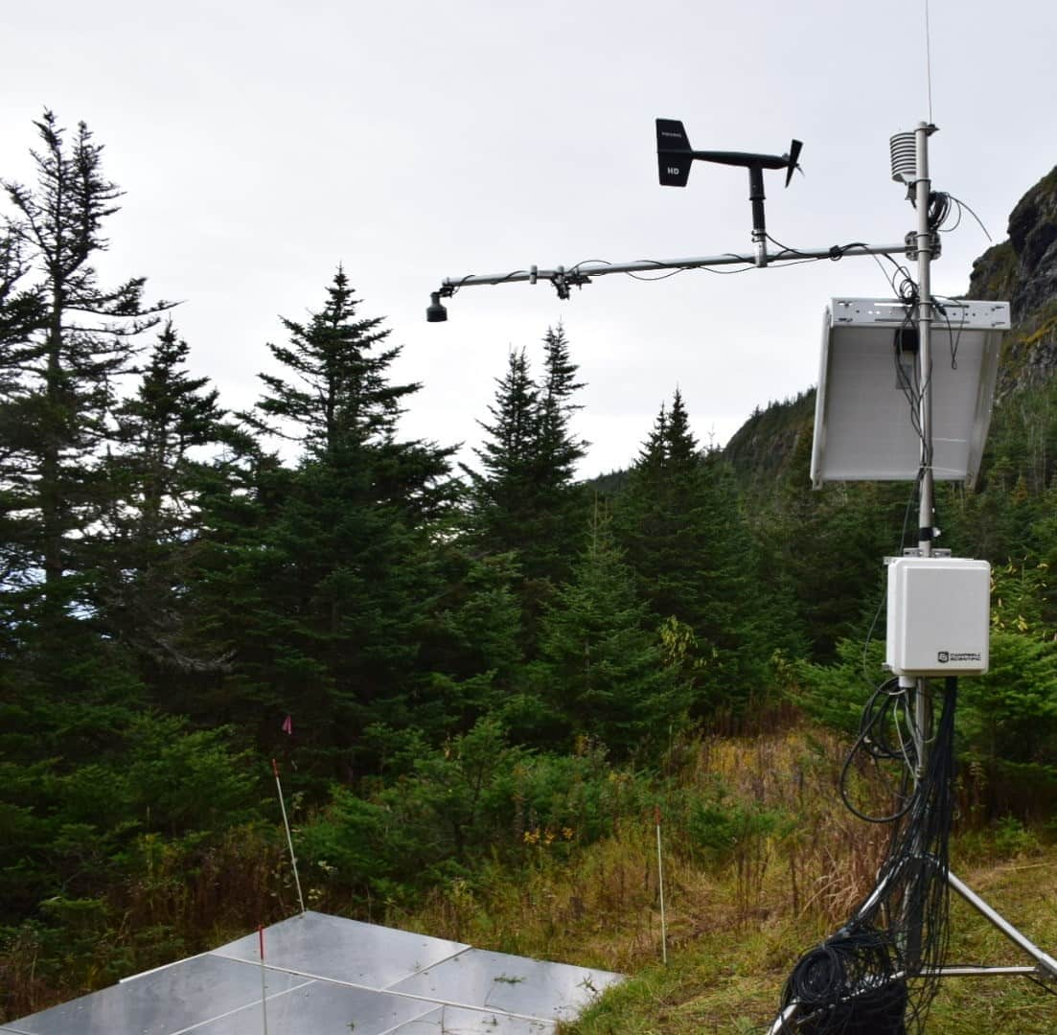
Primary objectives differ among networks for observation along elevational gradients
Photo Credit: Anna Grunes
Weather Forecasting
Climate Observation
Hydrological Monitoring
Focus on Weather Focus on Hydrology/Snow
Notes:
While different mountain monitoring networks may have unique primary objectives—for instance, weather forecasting, climate observation, or hydrological monitoring—the data from any network can still be invaluable for other secondary objectives.
Each station is designed for a specific purpose; for example, Mount Washington Observatory's stations are exposed to the elements to capture real-time weather and lapse rate data for forecasting.
In contrast, UVM's Summit to Shore project places stations in more sheltered locations that allow for accurate snow accumulation measurements.
It’s important for data users to have consistent metadata, so they are aware of these differences and can leverage our collective data to the greatest extent possible.

Slide 15
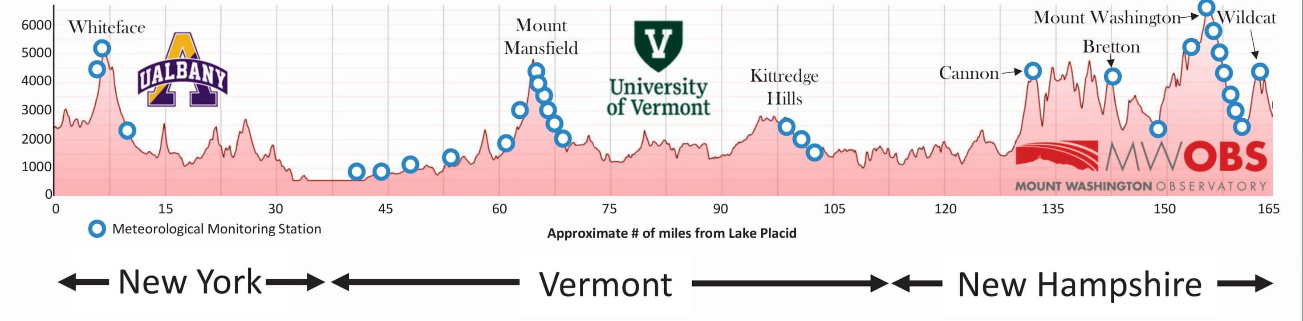
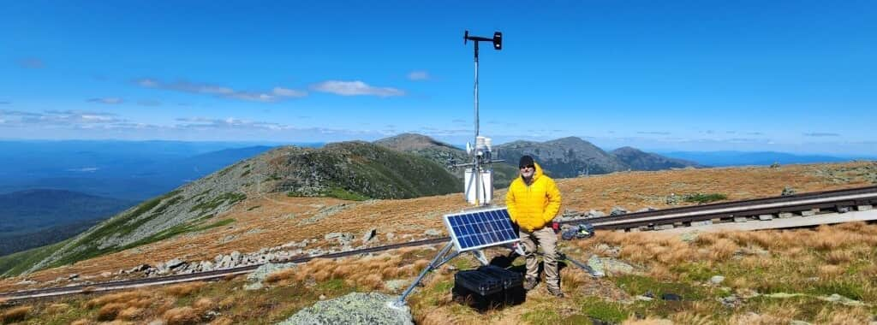
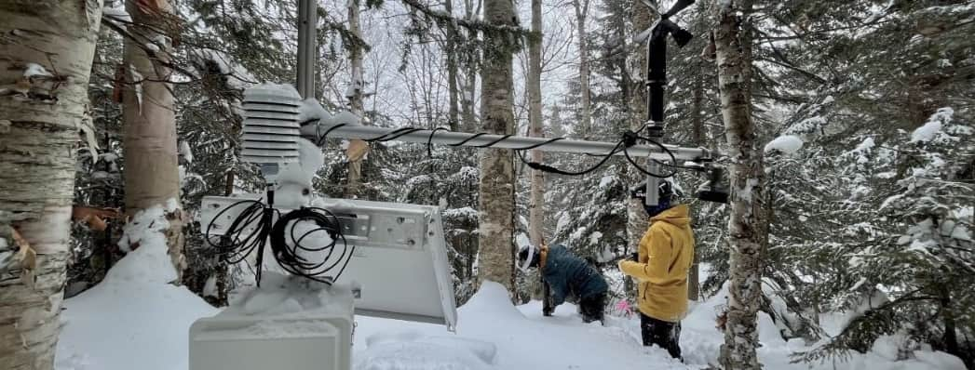
Data Driven Regional Resilience
Standardize Data: Ensure mountain observatories use common formats for data and metadata.
Enhance Forecasts: Partner with stakeholders to improve flood and snowmelt forecasting.
Align with International Methodologies: Update monitoring practices to meet national and global objectives.
Share Data Publicly: Create a public portal to make data FAIR (Findable, Accessible, Interoperable, Reusable).
Notes:
Our mountain observatories have collectively secured $500,000 grant from the Environmental Protection Agency’s Environmental Network fund.
This funding is a critical step in our work. We are using it to develop a shared web portal and metadata management strategy across three observation networks in three different states.
The goal is to ensure our data and metadata is standardized and aligned to better support weather forecasting and climate monitoring initiatives across the region.

Slide 16
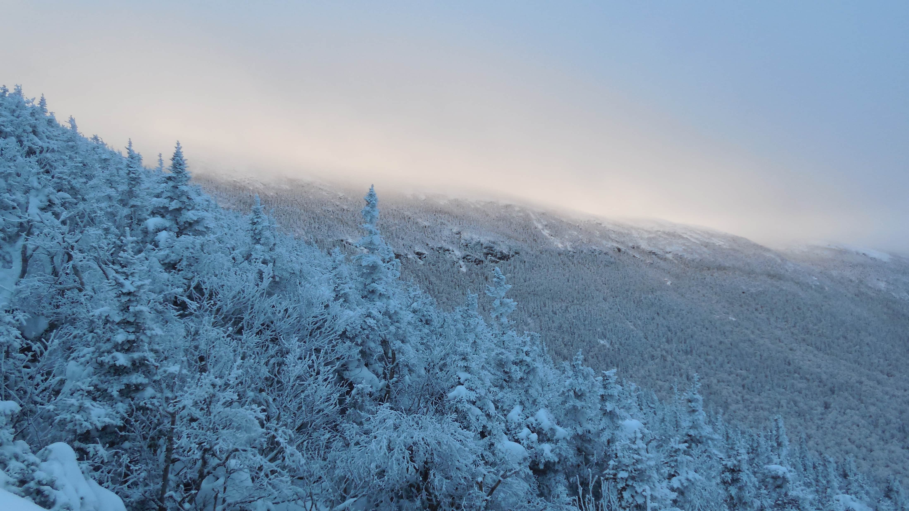
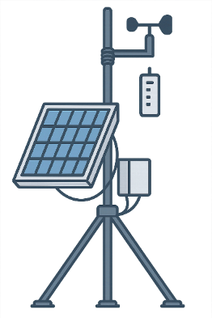
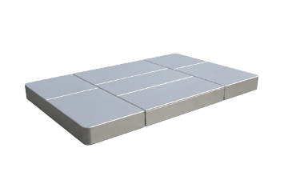
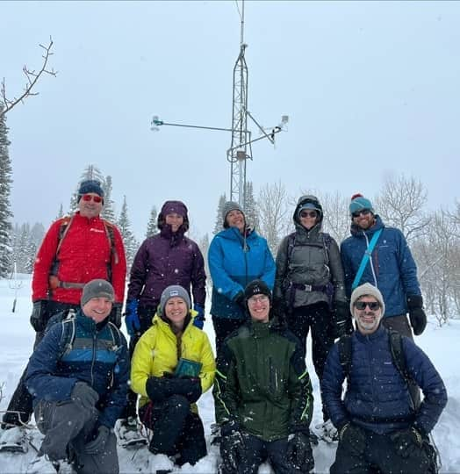
Northeast Snow Survey (NESS) Feasibility Study
Purpose: The NESS project aims to create an automated snow and weather monitoring network in the Eastern US to fill a significant data gap in the region.
Goal: The primary objective is to gain a better understanding of how climate change is impacting snowfall, runoff, and mountain ecology in the Northeast.
Model: The project is a feasibility study modeled after the successful Snow Telemetry (SNOTEL) network that operates in the Western US.
Notes:
Another major initiative for our network is the Northeast Snow Survey (NESS) Feasibility Study.
This $1 million federally appropriated project that is supported by the US Department of Agriculture Natural Resources Conservation Service.
The study aims to bring a coordinated, automated snowpack and climate monitoring network to high elevation areas in the northeast.
While the western United States have a robust SNOTEL network with over 900 stations, our region lacks a similar, cohesive system.
NESS is working to fill this gap by utilizing a systems engineering approach to quantify stakeholder feedback and design the network according to stakeholder needs.

Slide 17
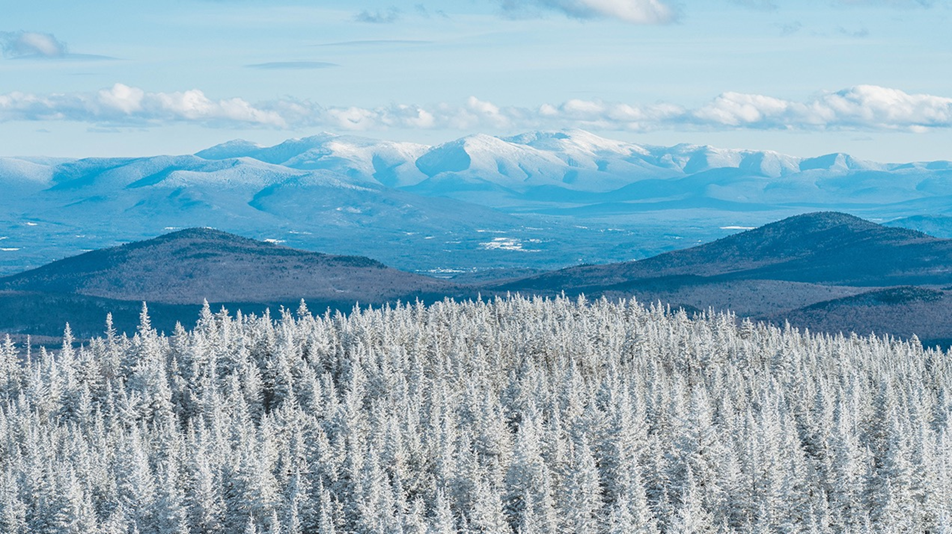
NESS Desirable Site Locations
Elevation: Between 700-2000 meters.
Slope: Less than 10 degrees.
Land Ownership: Publicly-owned.
Land Cover: Forested (coniferous, deciduous, or mixed) with small opening above.
Accessibility: Within 100 meters of a road.
Notes:
With stakeholder feedback now in hand, the NESS team is now working identify the most desirable locations for a future network of weather and snow monitoring stations across high-elevation areas in our region.
To achieve this, we are prioritizing sites with specific characteristics.
We're focusing on locations at higher elevations, specifically above 700 meters, with a slope of less than 10 degrees.
We are also limiting ourselves to accessible locations with public landownership.
By prioritizing sites with these characteristics, we can support our communities to have the data in hand needed to respond to mountain snowmelt and its associated flooding impacts.

Slide 18
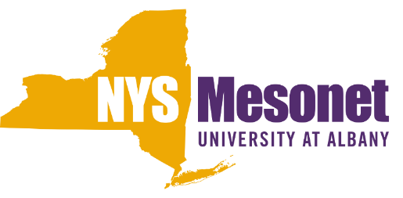
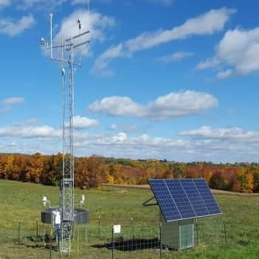


Mesonet Development
Mesonet
Notes:
Across our region, we also see a critical need to develop “gold standard” WMO certified weather monitoring stations across low elevations.
This effort is directly inspired by the well-established New York State Mesonet, which serves as a powerful model for what we can achieve.

Slide 19
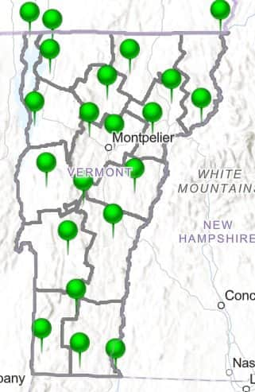

Mesonet networks in Northeastern USA
New York Mesonet – Established
Standard Observations
Precipitation
Temperature (2/9 m)
Humidity (2 m)
Wind Speed
Wind Direction
Surface Pressure
Soil Moisture
Soil Temperature
Solar Radiation
Photos
Snow depth
At least 1 station per county
Spaced ~17 miles apart
Reports every 5 minutes
Over 4,000 Sensors & Instruments
Vermont Mesonet – In Development
Notes:
The New York State Mesonet, with its 126 stations, provides real-time data that is invaluable for forecasting and emergency response.
I am currently leading the initiative to build a similarly robust network in my home state of Vermont (with proposed distribution of stations across the state in the figure to the right) and one of my collaborators is working to develop a similar mesonet network in Maine.
This collaborative approach, with a shared vision, similar density distribution plans, and standardized equipment where possible, will allow us to better support regional resilience for the future.

Slide 20





Alpine Micro-climate monitoring
HOBO Logger
Caitlin McDonough MacKenzie
cmcdonoughmackenzie@bennington.edu
Stephen Keller
Stephen.Keller@uvm.edu
TMS-4
Notes:
One unique component of our regional mountain climate observation efforts is an alpine micro-climate monitoring project funded by the National Science Foundation.
This initiative, primarily installed and maintained by plant researchers on high-elevation peaks, provides crucial insights into how changing climate conditions affect our region's most sensitive ecosystems.
While their primary objective is for ecological and biological research, the data they collect (which includes measurements of soil temperature, moisture, and ground-level temperature) provides an incredibly valuable addition to our network.
It provides a unique component to our mountain transects and will be a key piece of our overall monitoring strategy.

Slide 21


Unified High Elevation Observing Platform (UHOP)
A global initiative for consistent mountain climate and weather monitoring.
Goal: To fill data gaps, improve forecasting, and enhance community resilience.
Method: A multi-tiered network of stations along elevation gradients.
Tiers: Gold, Silver, and Bronze accreditation based on station density and quality.
Station Types:
Anchor: High-quality, long-term stations for baseline data.
Intermediate: Moderate-quality stations to fill data gaps.
Float: Low-cost stations for high-resolution spatial data.
Pepin, N.C., Beneš, J., Masiokas, M., Steiner, J., Thornton, J.M. & Williamson, S. (2024).
June 2023: Unified High Elevation Observing Platform (UHOP) Workshop – Bern, Switzerland
Notes:
Our efforts here in the Northeast are aligned with a major global initiative known as the Unified High-Elevation Observing Platform (UHOP).
UHOP is focused on creating a standardized protocol for observing weather and climate variables across elevational gradients.
By adopting these consistent protocols, our regional mountain observatory network can contribute to a global network of data that helps us better understand and predict elevation-dependent warming.

Slide 22









UHOP in the Northeast USA
NESS Stations
WMO (as far as practicable) with complete radiation balance.
SWE
Float Stations
Intermediate Stations
Mesonet Stations
WMO-certified meteorological observation in valleys
Notes:
We are uniquely positioned in the Northeast to implement the UHOP framework.
The Northeast Snow Survey (NESS) stations can serve as our high-elevation anchor stations, while the planned and existing mesonet stations will provide our low-elevation anchor points.
Between these anchors, we are utilizing smaller, more mobile sensors, such as the TMS-4 probes, to act as "float stations" that measure microclimate along the elevational transect.
Our existing work on Mount Mansfield and Mount Washington, with their intermediate stations, serves as a proof of concept for this model.
By connecting these various tiers of observation, we can create a powerful regional network that not only serves local needs but also contributes to global climate monitoring initiatives.

Slide 23

A model for the world
Prototype for UHOP: Our networks serve as a successful example for UHOP.
Regional Network: We are establishing a regional network of high-elevation observatories that can serve as a model for other networks.
Collaboration: Our project is a prime example of multi-institutional collaboration.
Enhanced Data Sharing for Resilience: We provide an example of enhanced data sharing for researchers, forecasters, and emergency personnel.
Notes:
Ultimately, our network's design and strategy offer a powerful framework that bridges across local and global needs.
We are creating a regional network that simultaneously serves our communities' immediate needs for things like flood and snowmelt forecasting while also contributing to major global initiatives like UHOP.
This dual purpose is made possible by our collaborative, multi-institutional approach. If any of you are interested to learn more about this model or how our region can best collaborate with other international mountain monitoring efforts, I would love to talk to you. Thank you!

Slide 24

Questions?
Joshua Beneš
Associate Director of
Research Facilities & Networks
University of Vermont
Water Resources Institute
jbenes@uvm.edu

